Slide 1
Sponsor Guide
Global Finance
SuperReturn Private Credit North America

Slide 2
Table Of Contents
Please click on a link below to go to directly to that section of the guide.
How to Login to the ConnectMe Platform | (Slides 3 – 8)
How to Edit your Virtual Booth | Details (Slides 9 – 12)
How to Edit your Virtual Booth | Videos (Slides 13 – 15)
How to Edit your Virtual Booth | Downloads (Slides 16 – 17)
How to Edit your Virtual Booth | Staff (Slide 18)
How to Download QR codes for your Documents (Slides 19 – 20)
Lead Retrieval |(Slides 21-25)
Your Lead Insights |(Slides 26-29)

Slide 3
ConnectMe Guide:
How to Edit Virtual Booths

Slide 4
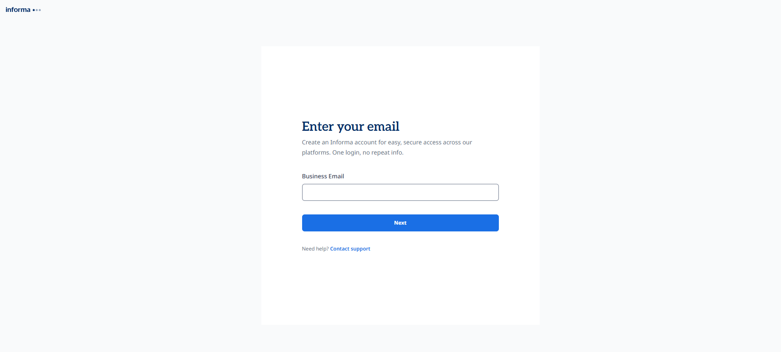
STEP 1 – LOGIN TO PLATFORM
Link to online platform: https://globalfinance.connectmeinforma.com/
Create your Informa account by entering your business email address

Slide 5
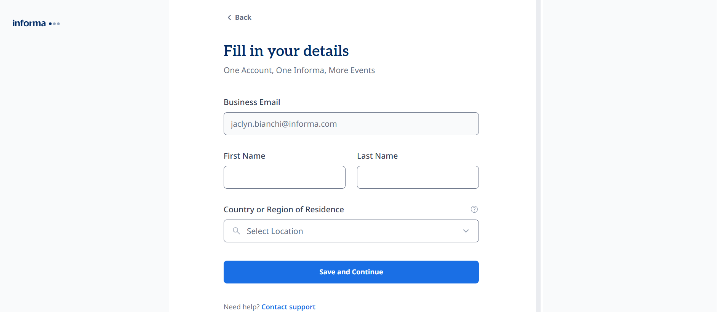
LOGIN TO PLATFORM cont…
Complete your profile

Slide 6
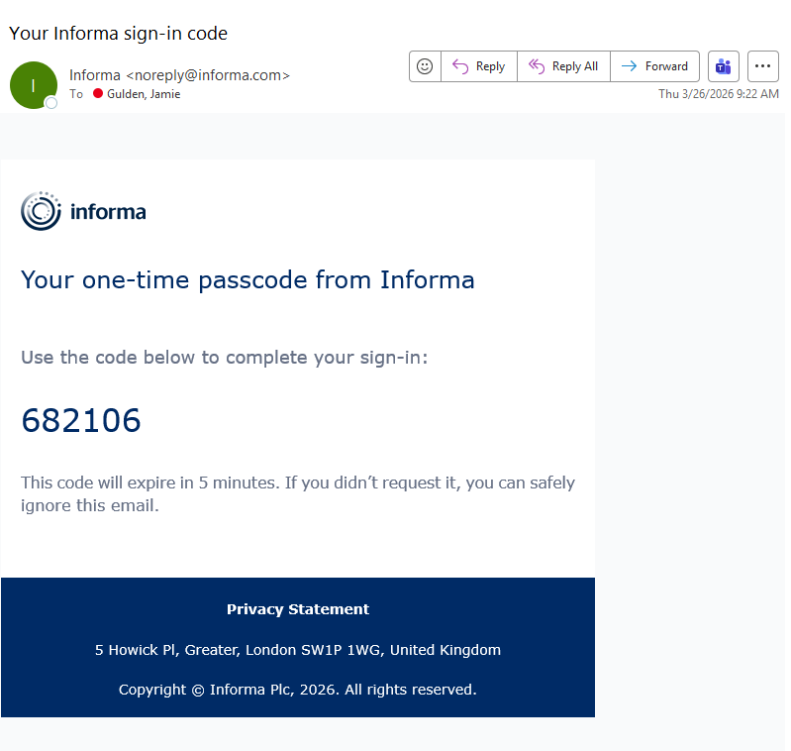
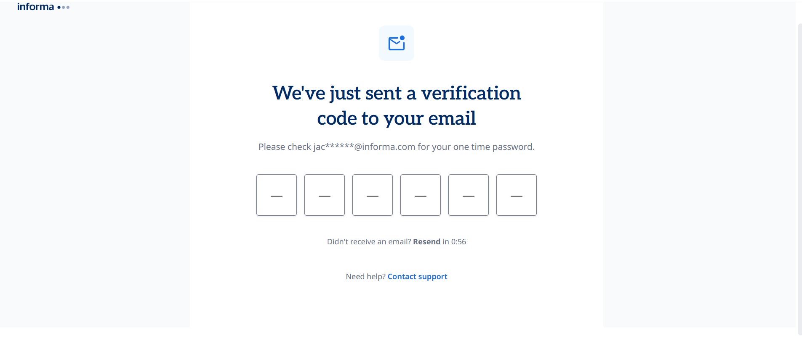
LOGIN TO PLATFORM cont…
Complete your profile
If you encounter any issues, Click “Contact support”

Slide 7
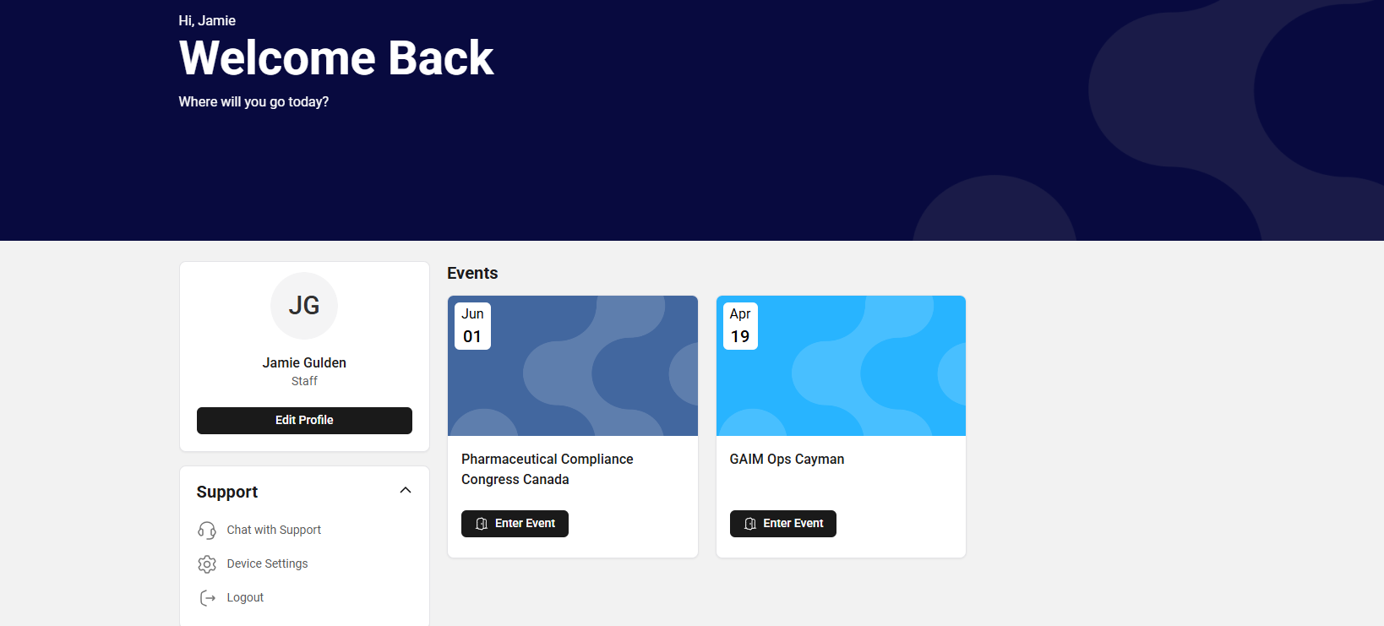
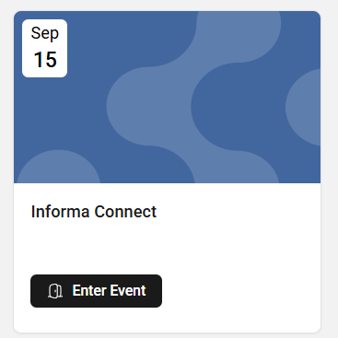
LOGIN TO PLATFORM cont…
SuperReturn Europe

Slide 8
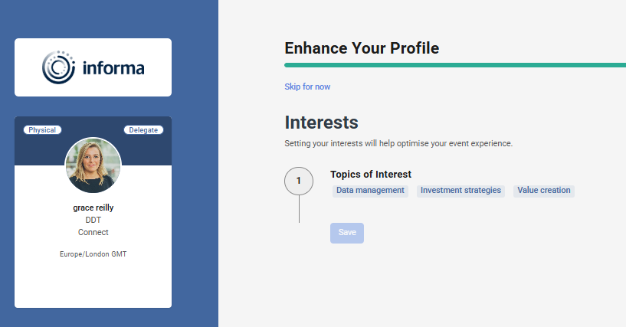
LOGIN TO PLATFORM cont…
Some events may require you to answer filter questions upon entry. If your event has this setup, it will look something like this.
Make your selection from the options available and “save”.
You will be able to update these options later by selecting "Edit profile" on the homepage and clicking on "Filters".

Slide 9
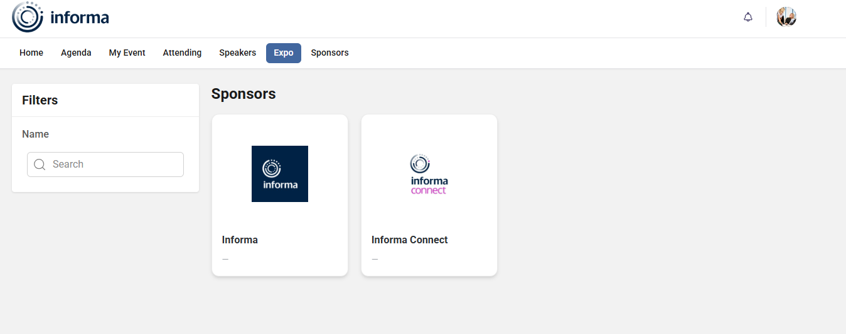
STEP 2 – FIND THE BOOTH REQUIRING EDITS
Click on the “Expo” tab.
Please note that your event may have renamed this tab. Common alternatives include Exhibit Hall, Sponsor List, Sponsor Booths, or Virtual Showcase.
Search for your company name
Click on the preview tile to access your booth

Slide 10
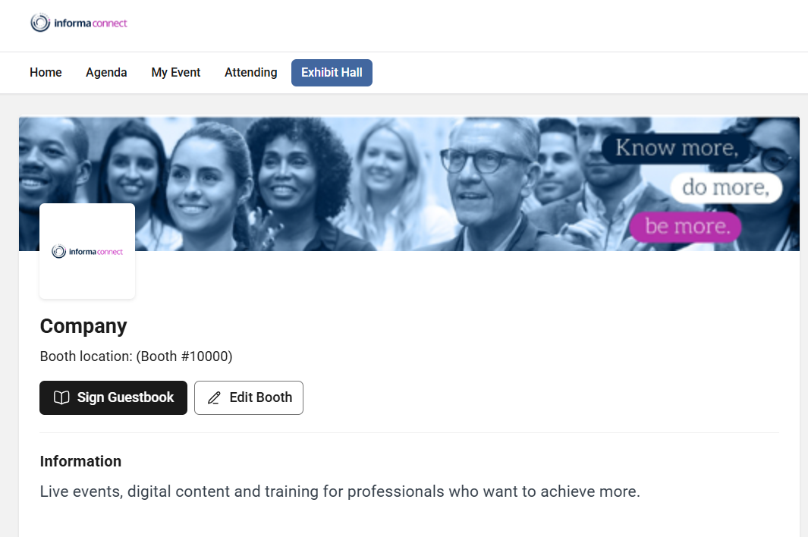
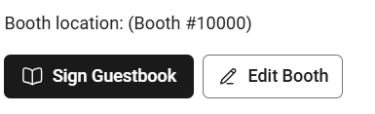
FIND THE BOOTH REQUIRING EDITS cont…
Select the "Edit Booth" button. Click it to update the virtual booth.
Please note: if you are unable to see the “edit booth” option, you will need to reach out to your event contact.

Slide 11
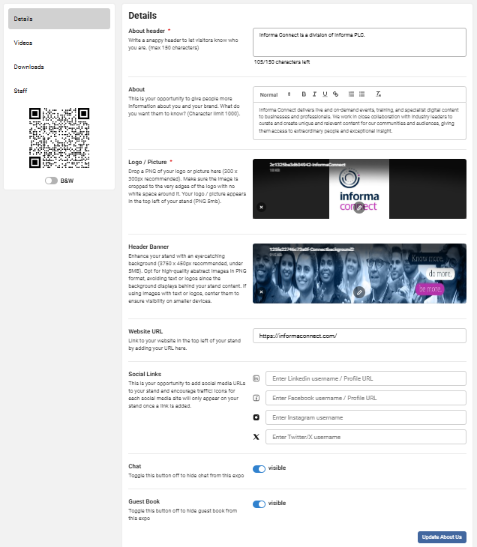
STEP 3 – BUILD BOOTH
Details: edit company details such as 'About Us', 'background', etc. Specs are listed beside each editable option.
Logo: The logo is automatically uploaded by our system and can not be edited here. If this needs to be changed, please contact Cat Farrer to ensure it is updated.
Header Banner: 1250 x 150px recommended. The background should be an abstract design without text or logos for the top of the virtual booth stand.
Please be aware that if a banner is not uploaded, none will be displayed.
Don’t forget to save changes by clicking on “Update About Us” at the bottom of the page.

Slide 12
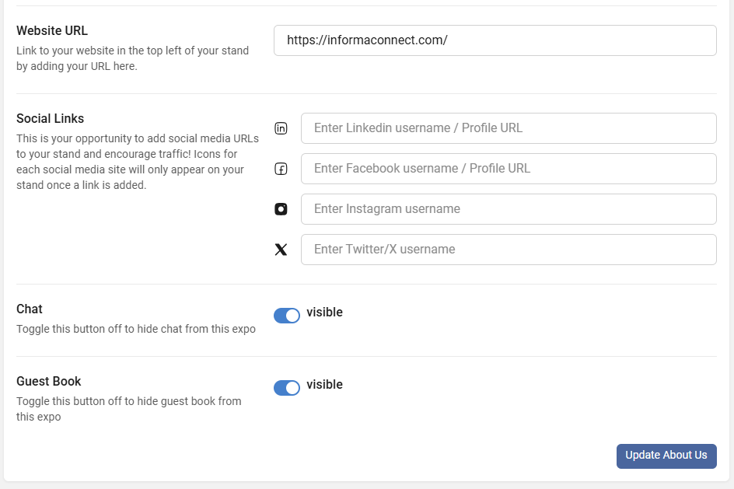
BUILD BOOTH cont..
Website & Social links: Only enter the username and not the entire URL
Chat & Guest book list: These interactive features are optional.​
​
They can be toggled “on” or “off”.
Don’t forget to save your changes by clicking on “Update About Us”

Slide 13
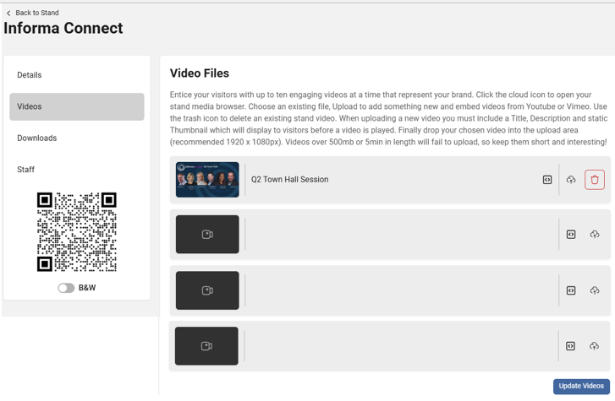

STEP 5 – ADD NEW VIDEOS
Videos: Here is an overview of all your videos. To add new videos, please click on the highlighted icon(s).
You can “embed” a video
Or you can “Upload” a video
Don’t forget to save all changes by clicking on “Update Videos”

Slide 14
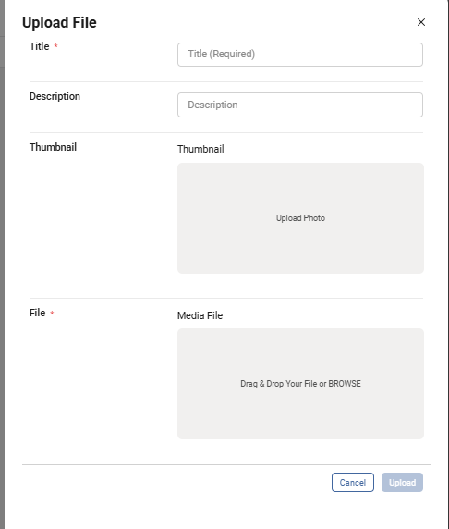
ADD NEW VIDEOS cont…
Complete video file details
Add your video file and select “upload”

Slide 15
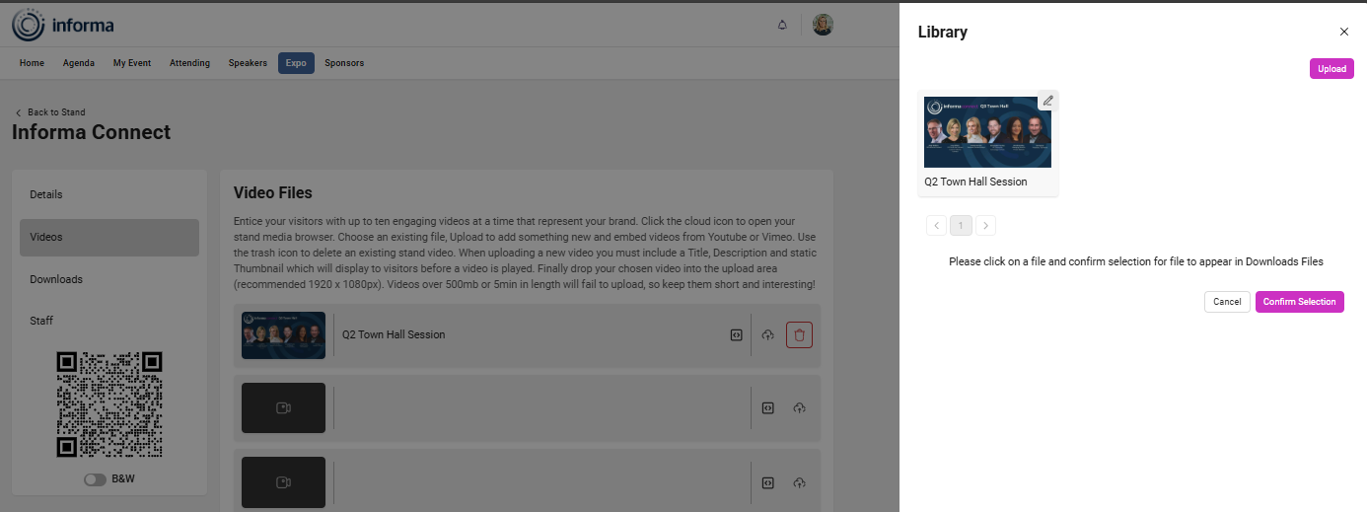
ADD NEW VIDEOS cont…

Slide 16
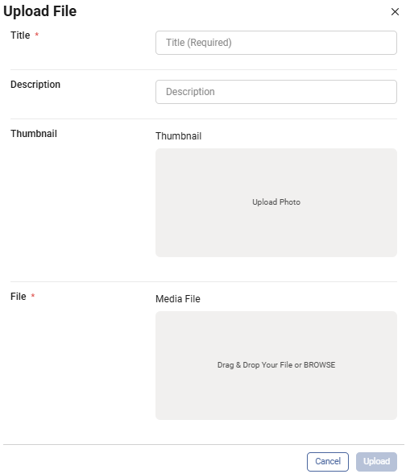
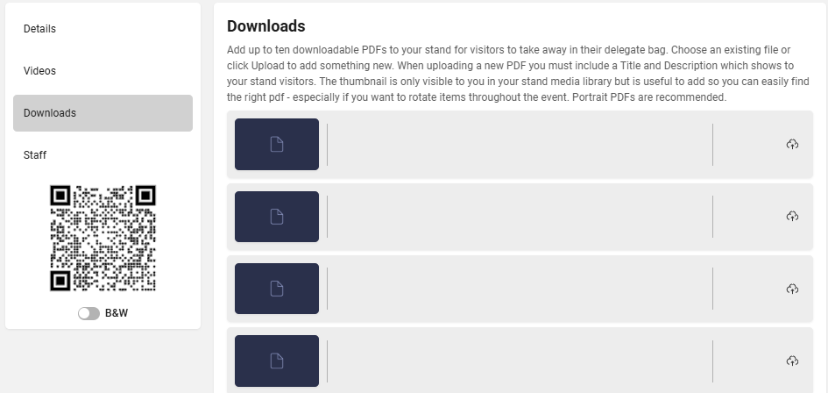
STEP 4 - ADD DOWNLOADABLE DOCUMENTS
Downloads: Add up to 10 downloadable PDFs to the stand.
Choose an existing file or click “the cloud Icon” to add something new. Complete details, and then select the “upload” button to add.
Thumbnail: add a screenshot of the first page or an image of your choice.
Without a thumbnail, the preview on the front end will be a blank image (5MB PNG image).

Slide 17
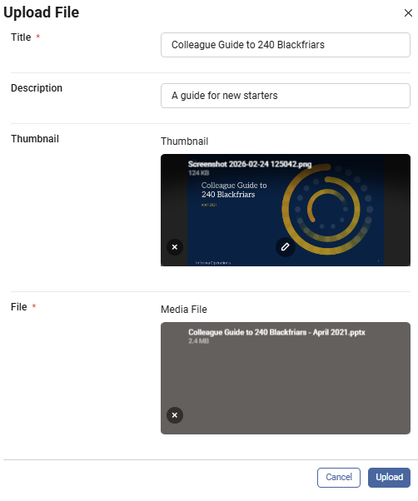
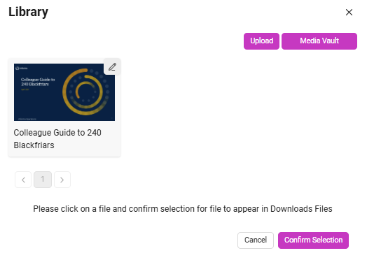
ADD DOWNLOADABLE DOCUMENTS cont…
Once your file has been uploaded, it will appear in the “Library”.​
​
Select the video file and then click "confirm upload" to add it to your virtual booth
If your video doesn’t appear in the library immediately, try refreshing the page, closing the library, and clicking the upload icon again.

Slide 18
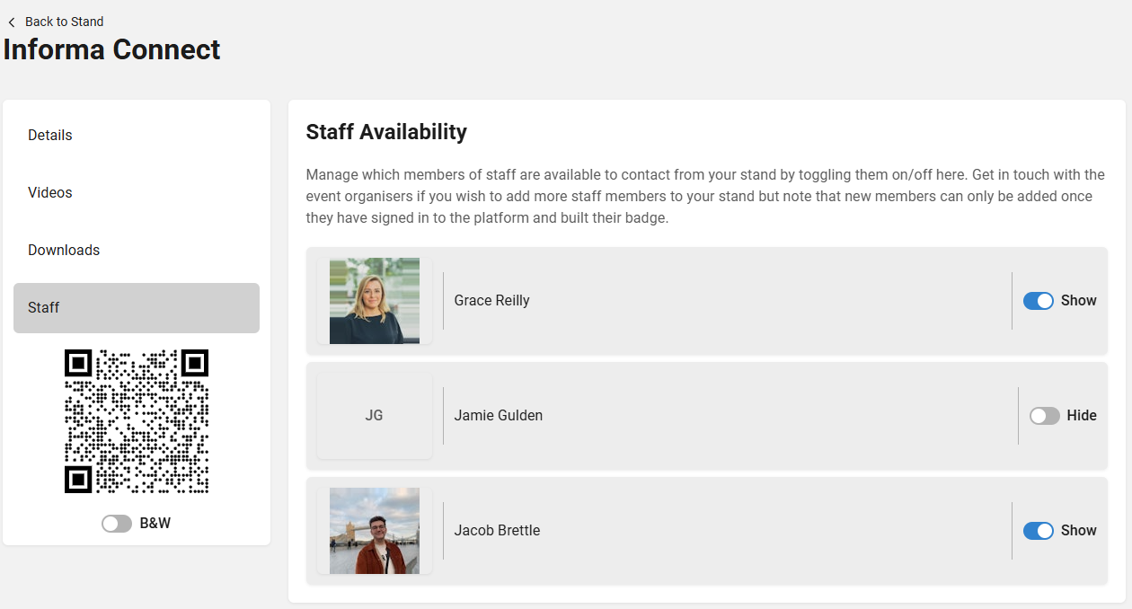
STEP 5 – STAFF
Existing Representatives can be managed here.
You can toggle their visibility to attendees on or off using the “Show” and “Hide” toggles.
If additional staff need to be added, this will need to be actioned by the event organiser. Please contact gfsupport@informa.com for assistance.

Slide 19
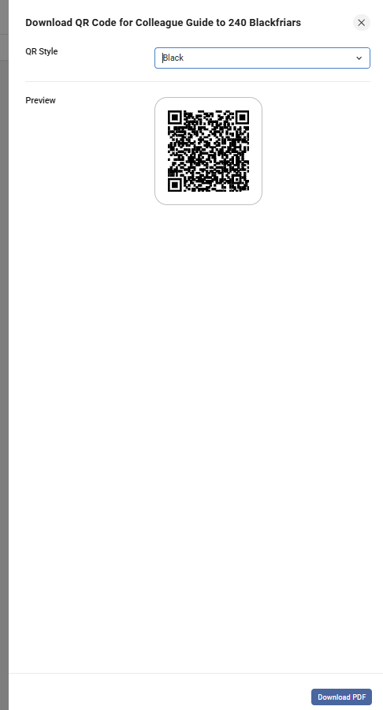
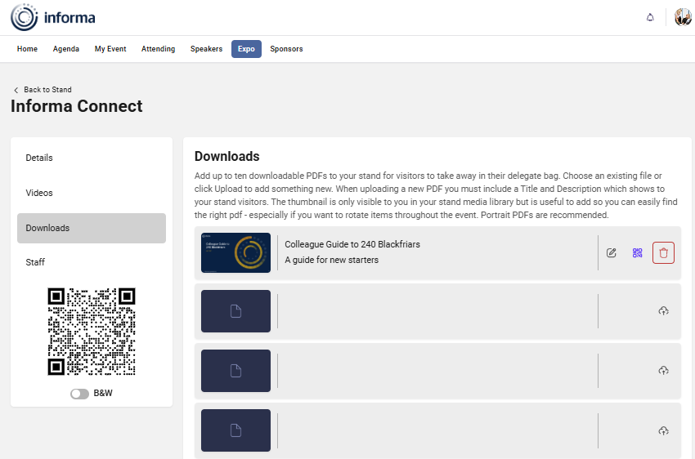
STEP 6 – QR CODES
You can print a QR code, which can be scanned by attendees onsite at your booth to download your documents for later viewing. All downloads come in 1 file

Slide 20
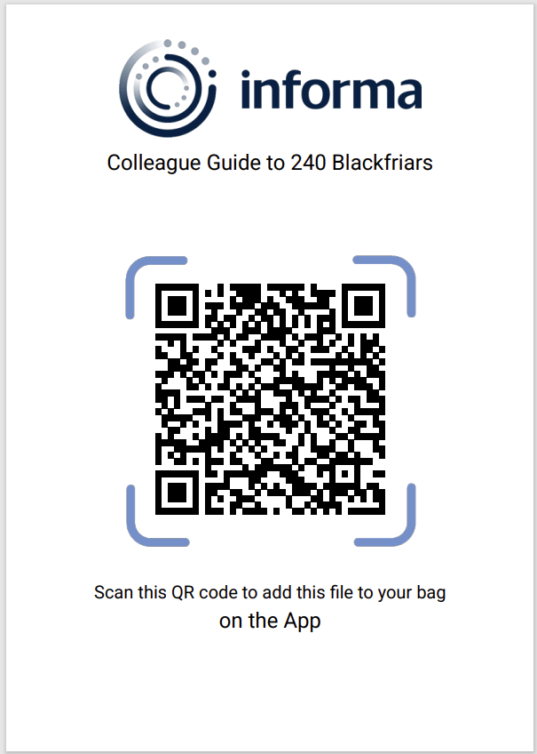
QR CODES cont…
Title to match uploaded file
When you click to download, all your uploaded documents will be linked to the respective QR codes for you to print and bring onsite.

Slide 21

Lead Retrieval

Slide 22
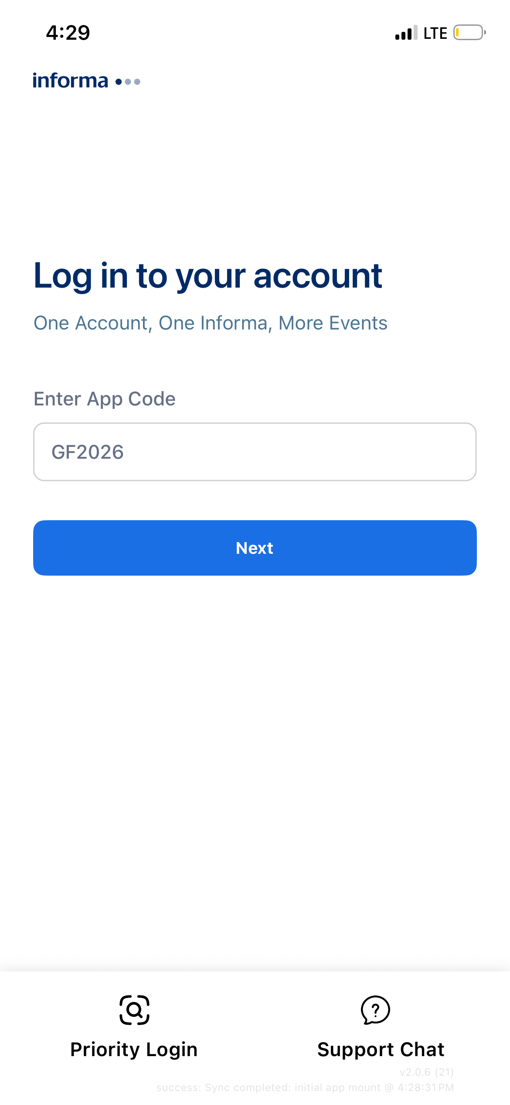
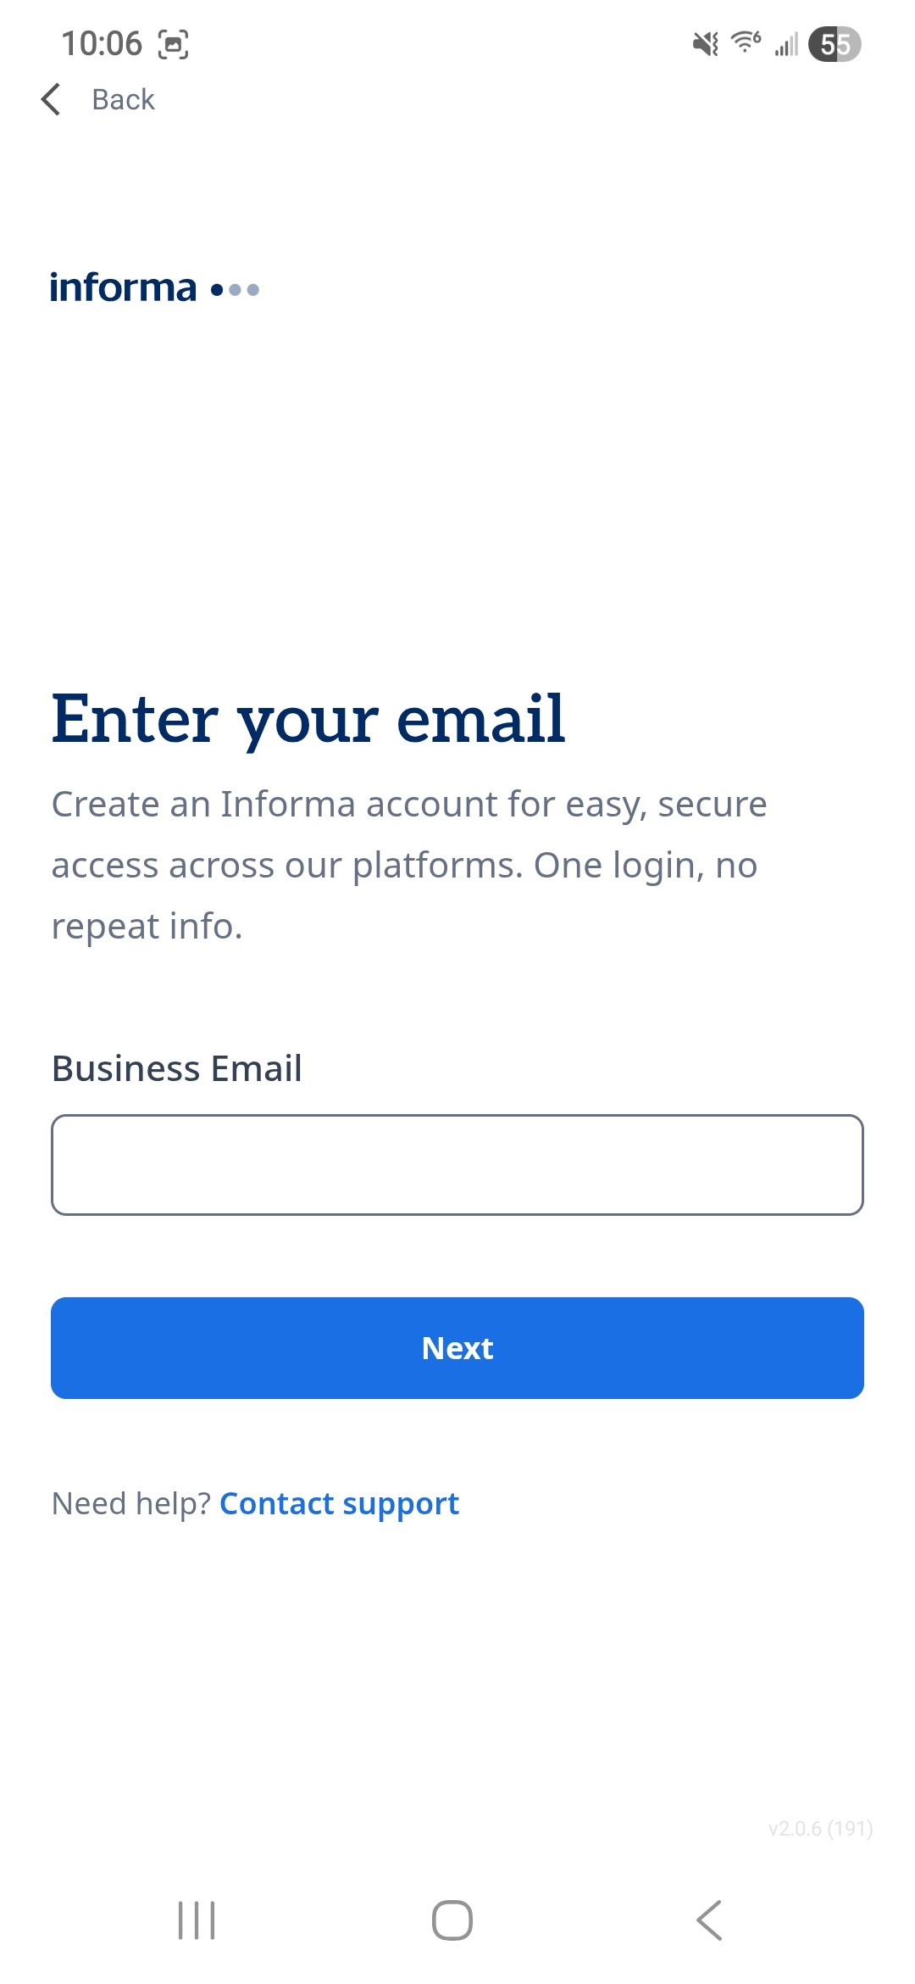
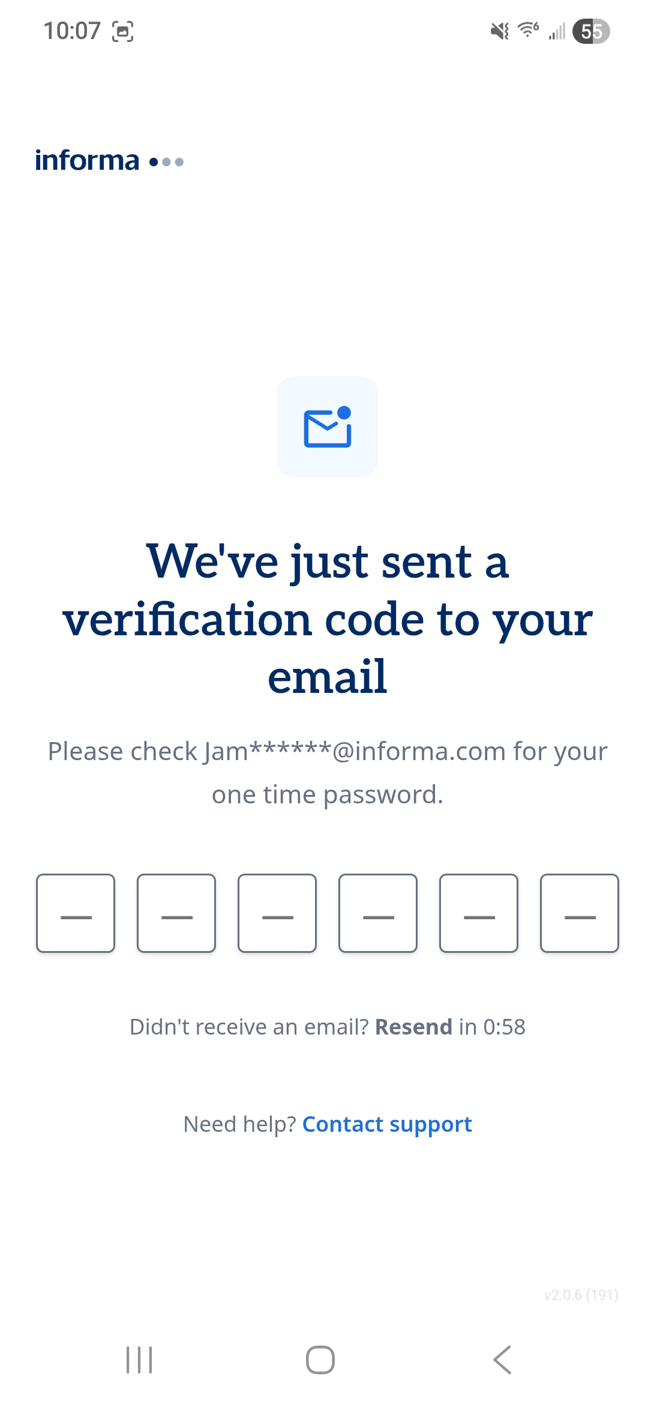
LEAD RETRIEVAL – HOW TO SETUP, SCAN & COLLECT LEADS ONSITE
On your phone or tablet, please download the ConnectMe app. To find it in the App Store / Google Play, please search ‘ConnectMe by Informa’.
Once downloaded, please enter the App code: GF2026
Enter your email address used to register for the conference, to which you will receive a 6-digit pin to login
If you do not receive a 6-digit pin, please use ‘Contact Support’.
If you do not receive a 4-digit pin, please email

Slide 23
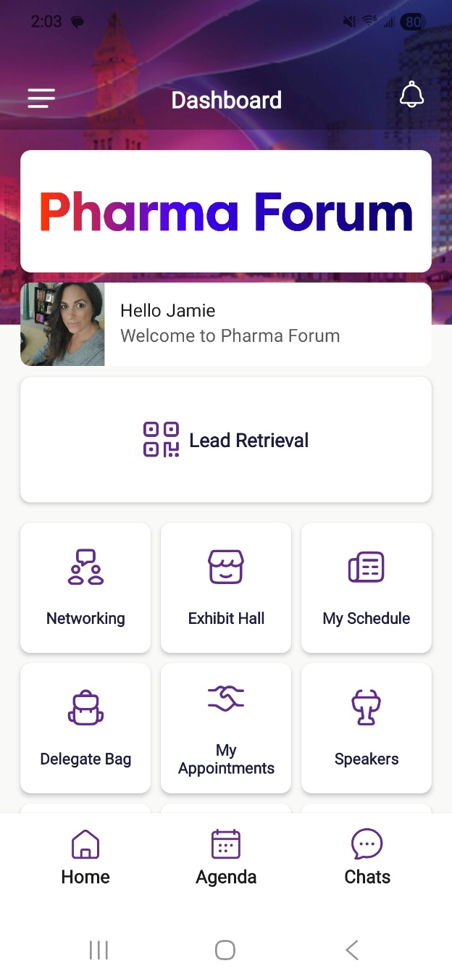
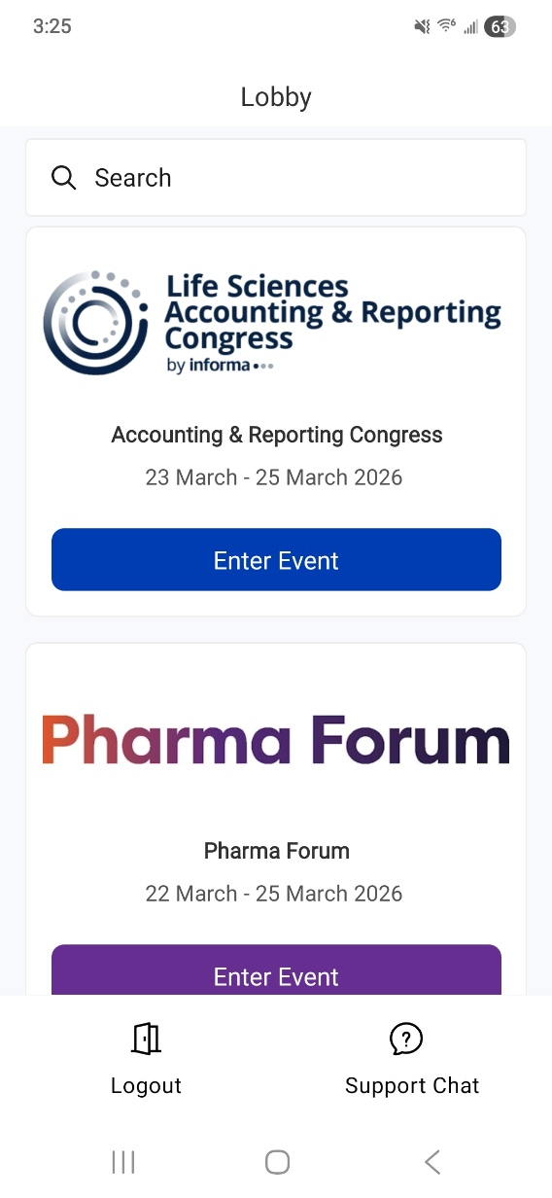

LEAD RETRIEVAL
4. Once entered, please select the event to enter. The dashboard on the right will appear and you will have the Lead Retrieval button which will take you to the lead scanning page.
If you do not see this button on your screen, please contact your Digital Event Ops Contact which can be found at the end of this document.

Slide 24
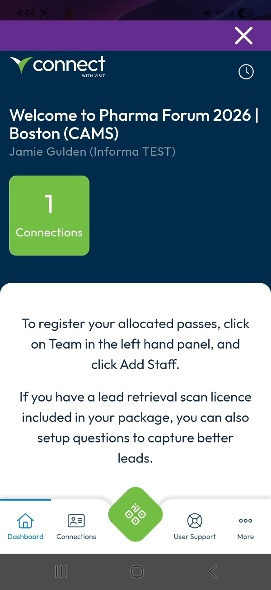
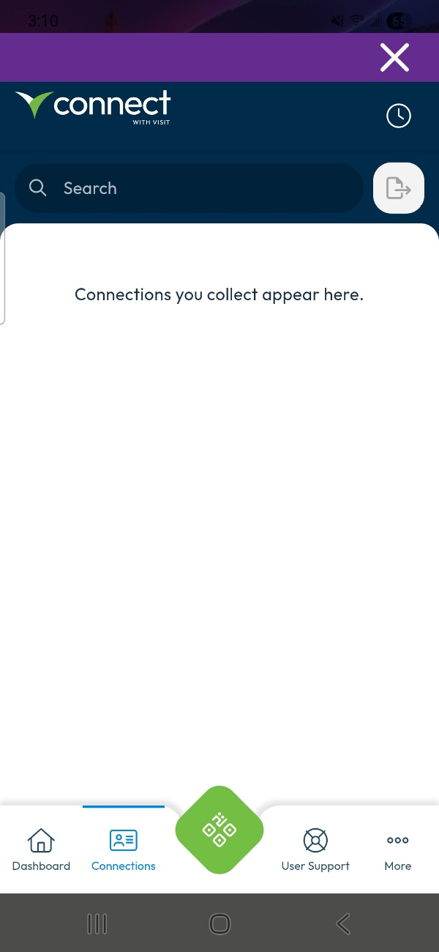
LEAD RETRIEVAL cont…
5. This takes you to the partner portal for
capturing leads. To begin scanning click the
QR button at the bottom of your screen. ​
​
​
6. Make sure your camera permissions are set to
“allowed” in order to scan.
*The specific name of your event will be shown

Slide 25
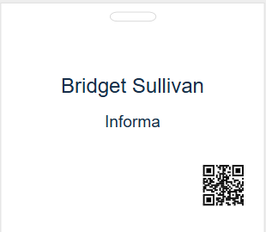
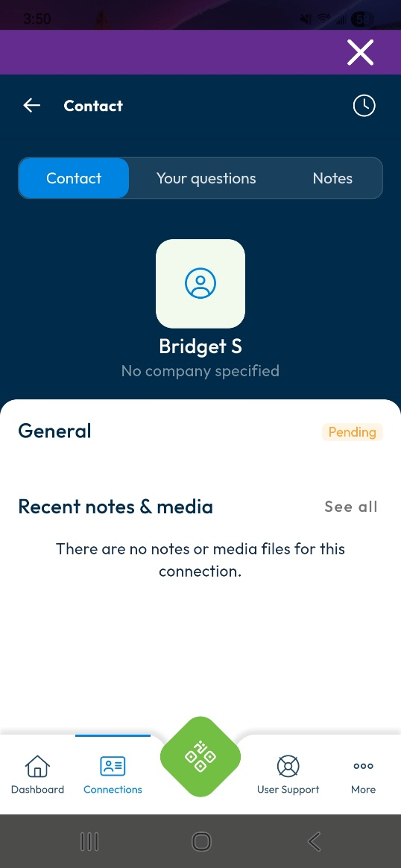
LEAD RETRIEVAL cont…
7. QR codes will be printed on attendee badges as seen in this example.
When scanning, please ensure you are scanning the QR code on the attendee badge, and not the QR code attached to their lanyard.
Once scanned, the page will show the attendee details and you are then able to add your own notes/media files and answer any preset questions that your company has added.
8. Click the back button at the top left to go back to your main dashboard. This will show all the leads you’ve personally scanned.
*The specific name of your event will be shown
This badge is an example and can not be scanned

Slide 26



3 Critical Delivery Platforms for Sponsors & Exhibitors
Access lead retrieval to scan attendee badges*
View attendee directory
Send direct messages and meeting invitations
Set up and view virtual exhibit booths
Access event content agenda
Stream live (hybrid events) and on-demand sessions
Scan exhibit booth QR codes
Who has access?
Sponsors, speakers and all attendees
  Download the app
  Enter App code: GF2026
  (Event registration required to use conference app)
*All sponsor team members should see a “Lead Retrieval” button on the home screen of the ConnectMe app.
CONFERENCE
APP
Key Support Contact
Event Ops
[olivia.uduji@informa.com]
REGISTRATION SYSTEM
Register staff with contracted complimentary event passes
Access all badge scan data captured by your team
View badge scan notes
Set up custom badge scan questions
Who has access?
Sponsor’s main contact only
Your main contact will receive pre-event access via email to set up your team registration and lead retrieval
Key Support Contact
Exhibitor Ops
[gfsupport@informa.com]
Access all your event leads, including session attendance, booth/badge scans, scan notes, virtual booth visits, and more
View individuals/companies that are most engaged with your company
Export your full event lead data
Lead data is updated throughout event
Who has access?
Contract signer and main contact
You’ll receive an email pre-event with access to your account, and you can extend access to colleagues. If you have questions about your lead data or access, please contact us.
LEAD REPORTING & ANALYTICS
Key Support Contact
Lead Data Delivery
leadinsights@informa.com
Sponsor Guide

