Slide 1
Sponsor Guide
SuperReturn International 2026

Slide 2
Table Of Contents
Please click on a link below to go to directly to that section of the guide.
How to Login to the ConnectMe Platform | (Slides 3 – 8)
How to Edit your Virtual Booth | Details (Slides 9 – 12)
How to Edit your Virtual Booth | Videos (Slides 13 – 15)
How to Edit your Virtual Booth | Downloads (Slides 16 – 17)
How to Edit your Virtual Booth | Staff (Slide 18)
How to Download QR codes for your Documents (Slides 19 – 20)
Lead Retrieval (Slides 21 – 29)
Your Event Contacts (Slide 30-31)

Slide 3
ConnectMe Guide: How to Edit Virtual Booths

Slide 4
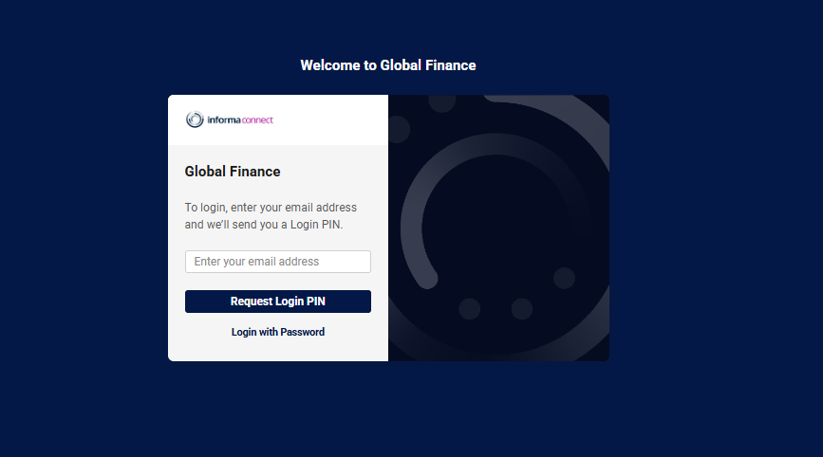
STEP 1 – LOGIN TO PLATFORM
Link to online platform: https://globalfinance.connectmeinforma.com/ Please use the login details you have received by email.
Enter your email.

Slide 5
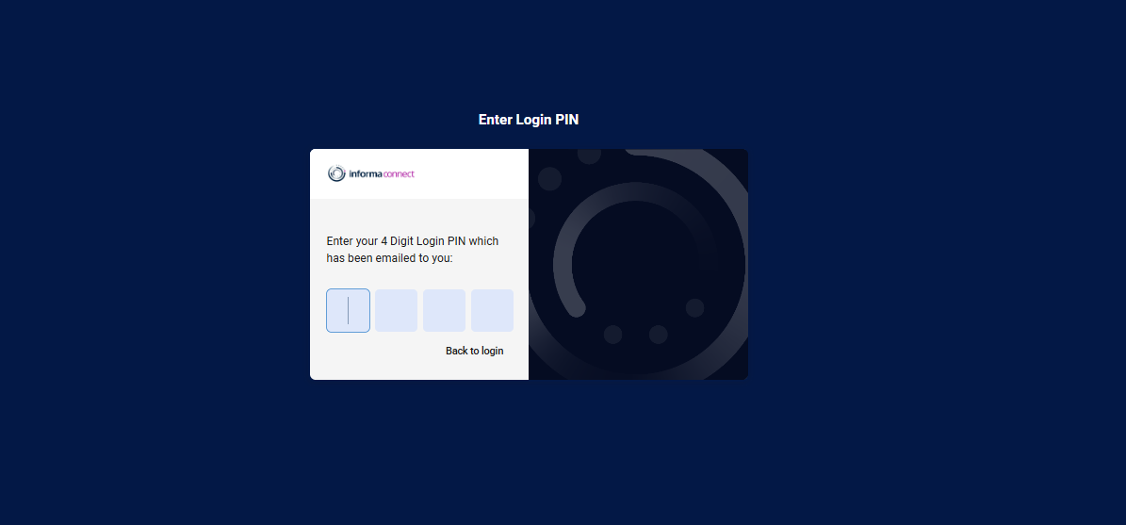
STEP 1 – LOGIN TO PLATFORM
Enter your email.
You will be emailed a 4-digit code that will redirect you to the platform. Please use the ‘Chat with Support’ if you do not receive the email. It will come from “Totem”

Slide 6
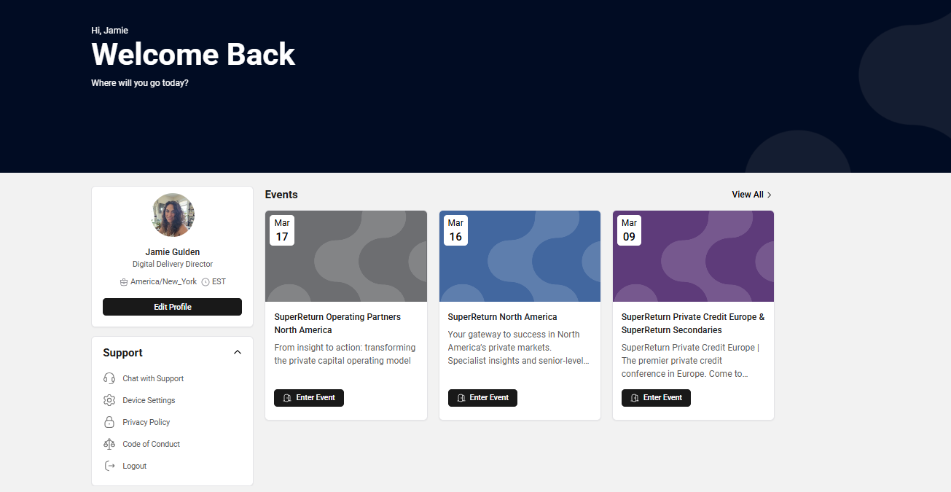
STEP 1 – LOGIN TO PLATFORM
Your event name will be located here. If you do not see an event, please reach out to your contact. You may only see the current event you are attending or others if you may be registered for.
Click enter event

Slide 7
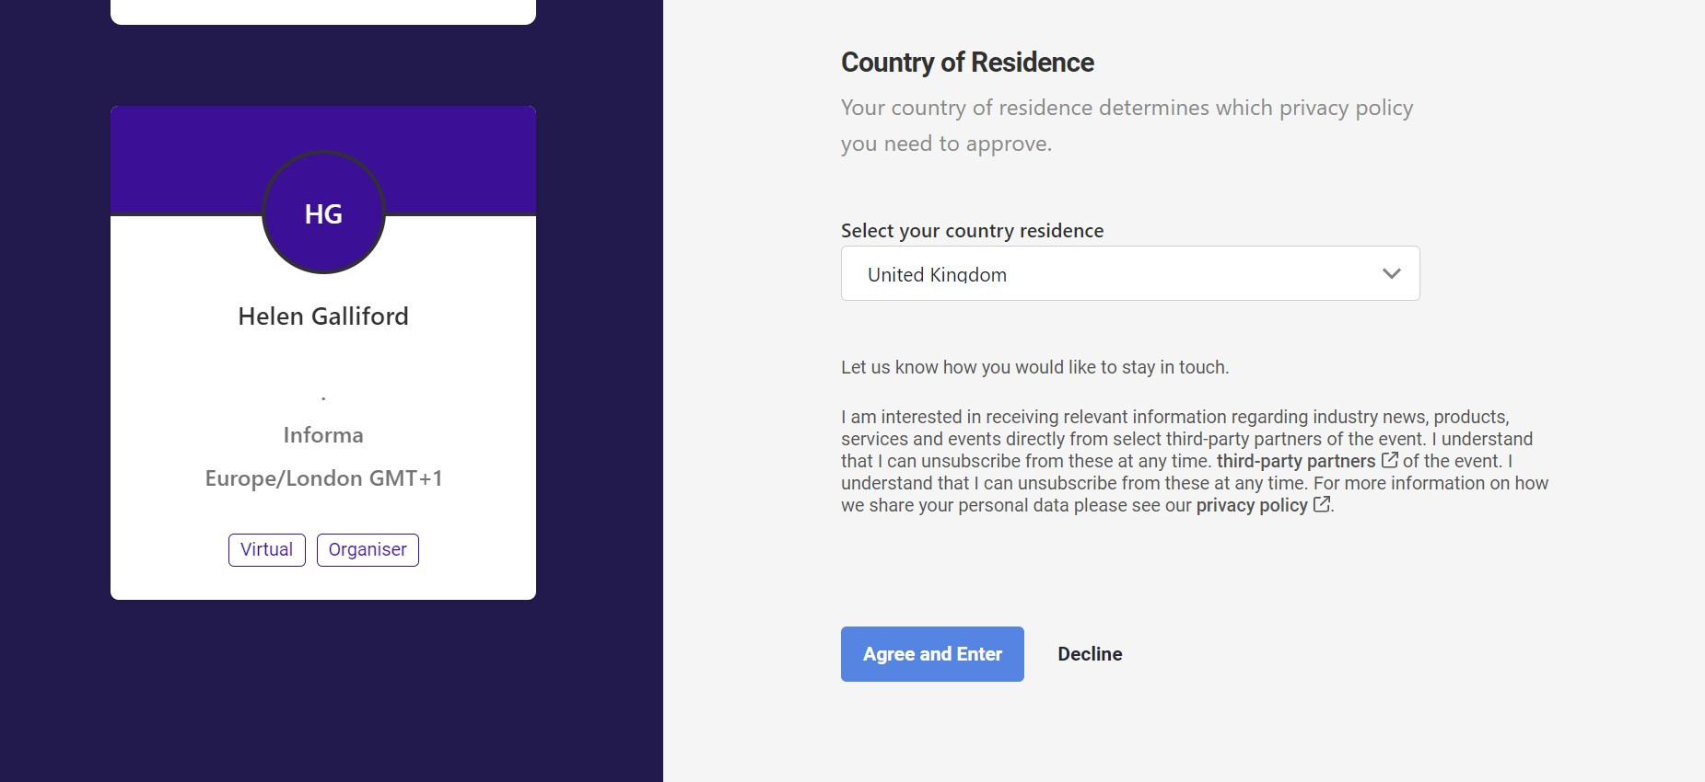
STEP 1 – LOGIN TO PLATFORM
If this is your first time entering the event, You will be asked to choose your country of residence from the drop down

Slide 8
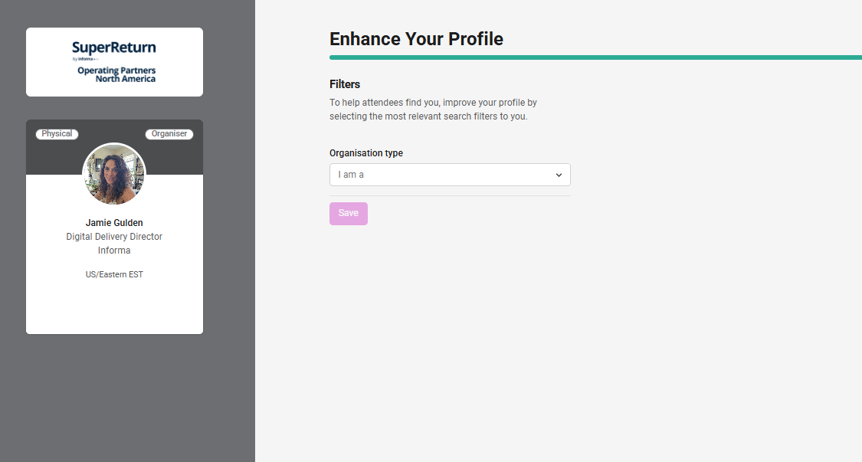
STEP 1 – LOGIN TO PLATFORM
Some events will first ask you to choose some filters. This could happen regardless if you are attending the event or are just a support staff.
Not all events will have this page- skip to next step

Slide 9
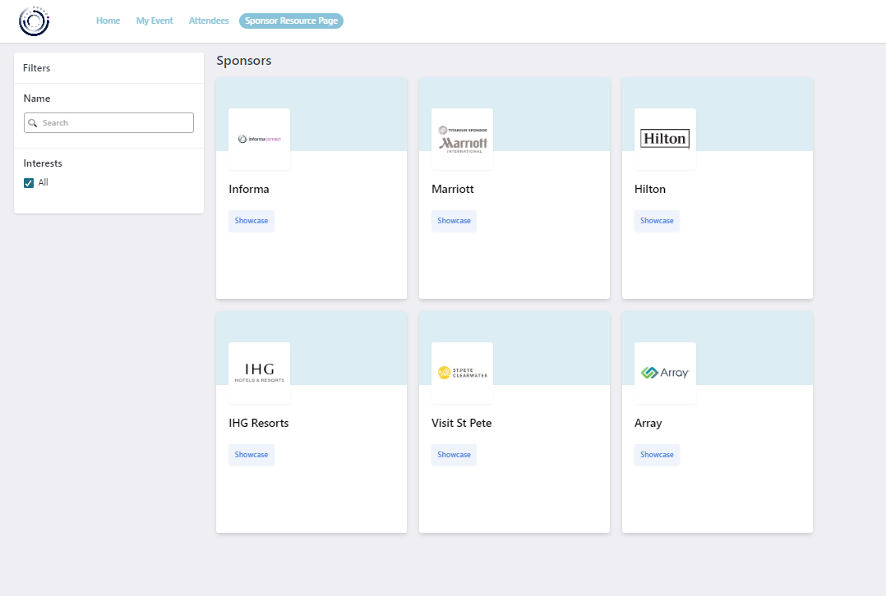
STEP 2 – FIND YOUR BOOTH
Exhibit Hall
Click on the “Exhibit Hall or Expo (this could vary per event)” to see a list of all sponsors and partners.
Search for your company name
Click on “Showcase” to access the booth.

Slide 10
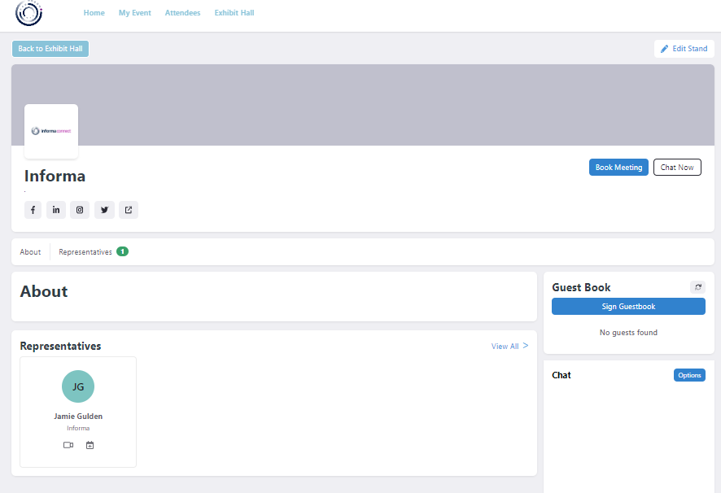


STEP 3 – BUILD YOUR BOOTH
You can change the settings, by clicking on “Edit Stand”. Only representatives can edit the booth.
If you don’t have this permission, please send an email to your Informa contact.
Book Meeting & Chat Now: Interactive tools that can be used by attendees to either book a meeting with Reps or send a message on Chat.
Social media links
Representatives: will show all registered staff from your company attending the show (all attendee’s will be registered 2 weeks before the event).
About: short company description
Guest book: Lead capture tool that can be used by attendees. You can export a list of all guests who signed by clicking on the Spreadsheet icon.

Slide 11
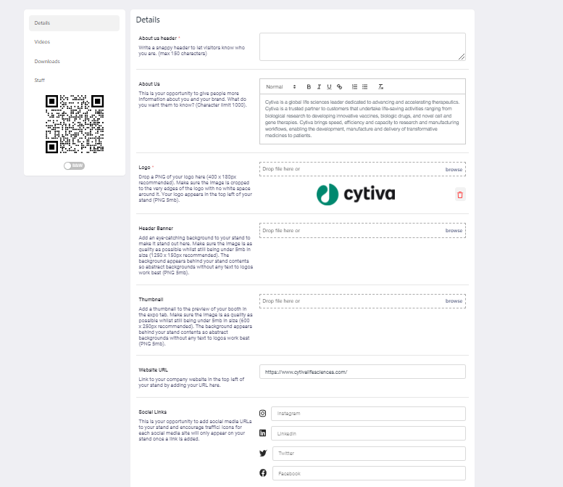
STEP 4 – BUILD YOUR BOOTH
Details: An overview of your booth. You can edit all your company details such as 'About Us', 'Background', etc. Specs are listed besides each editable option.
Don’t forget to save your changes by clicking on “Update About Us” at the bottom of the page.
Logo: The logo is automatically added from our records and can not be changed here. If this needs to be updated, please contact superreturninternational.ops@informa.com
Header Banner: 1250 x 150px recommended. The background appears at the top of your stand so abstract backgrounds without any text to logos work best.
Thumbnail: 600 x 250px is in the lobby of the Exhibit Hall - we will provide one for you if you choose not to add one of your own.

Slide 12
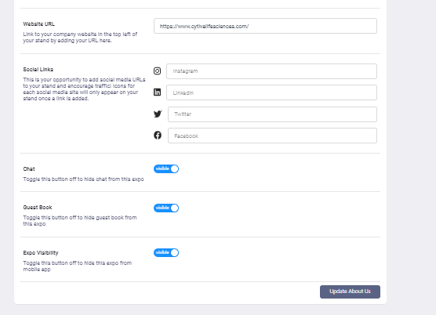
Website & Social links: The links must include the prefix https://
Content Tags: If these have been provided for the event, pick up to 10 tags that best define your stand to help the most relevant attendees find you. Attendees can filter stands by specific tags on the Expo overview page. Chosen Helix tags will also appear in the top left of your booth, underneath your logo.
Chat & Guest book list: Interactive tools. We recommend keeping both of these toggled on.
Don’t forget to save your changes by clicking on “Update About Us”

Slide 13
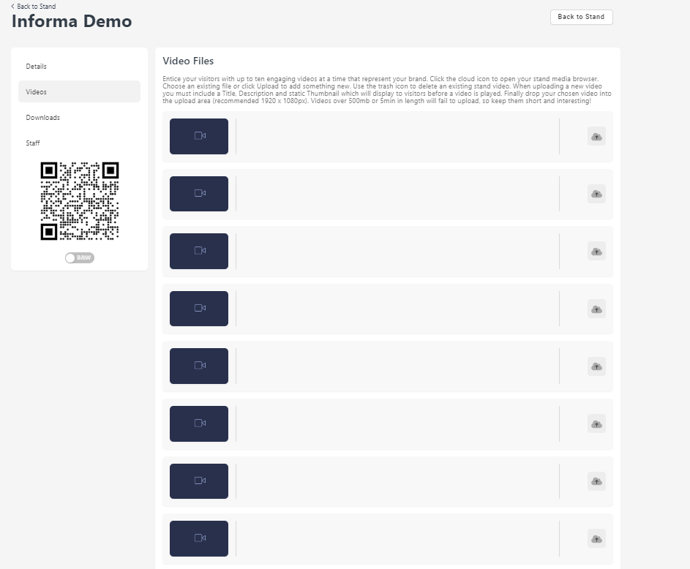
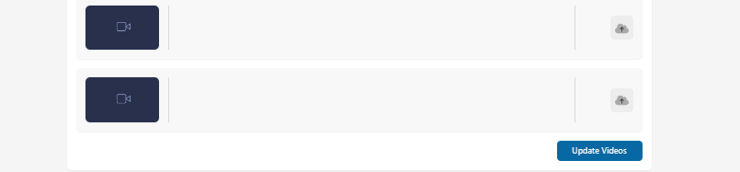
STEP 5 – ADD NEW VIDEOS
Videos: An overview of all your videos. To add new videos please click on the icon highlighted.
Don’t forget to save all changes by clicking on “Update Videos”

Slide 14
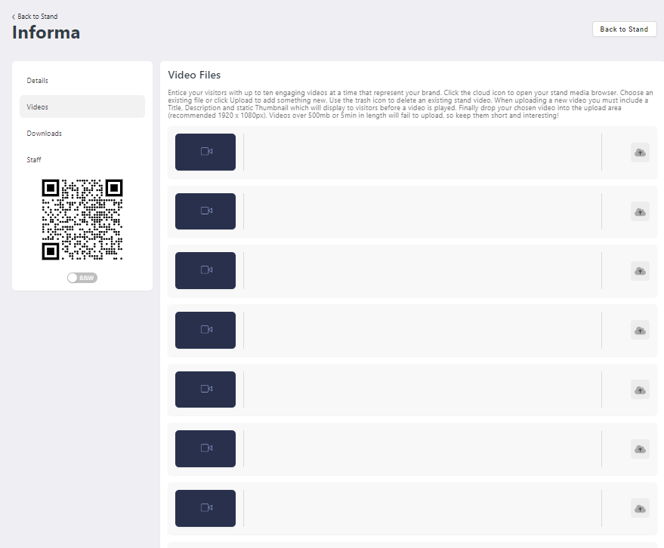
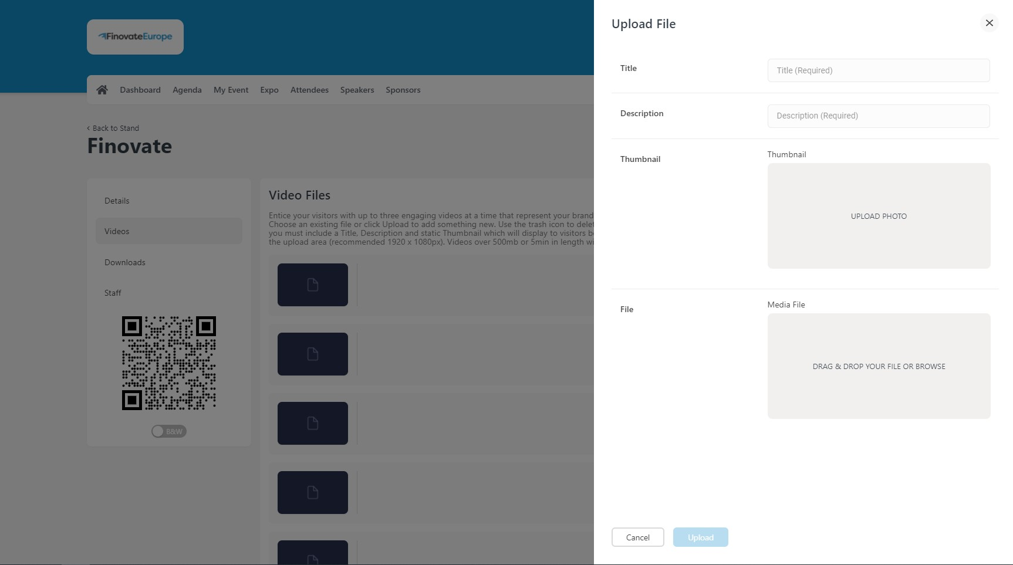
STEP 5 CONT.– ADD NEW VIDEOS
Add all required information – Title, description, thumbnail and the file.
Thumbnail: Pause your video and take a snapshot of the video (5MB PNG image).

Slide 15
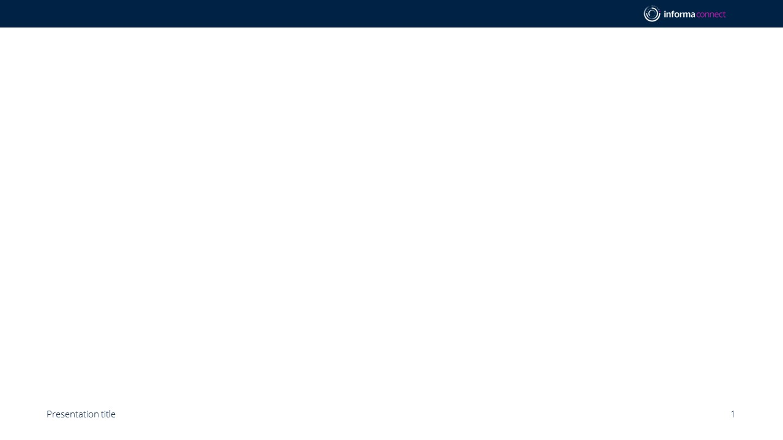
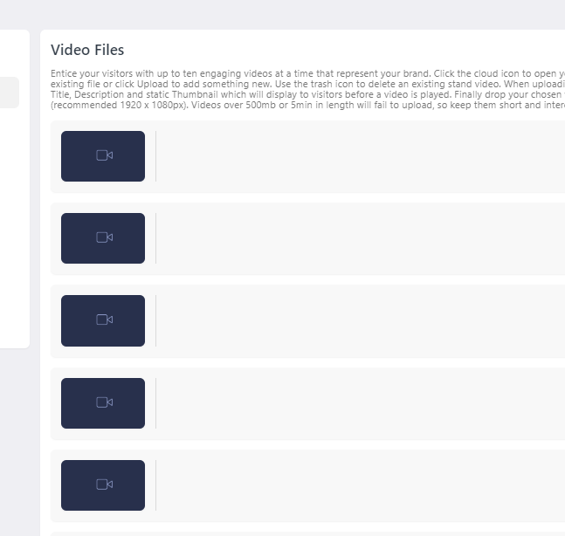
STEP 5 CONT. – ADD NEW VIDEOS
Select the file in the library and press “Confirm Selection.”

Slide 16
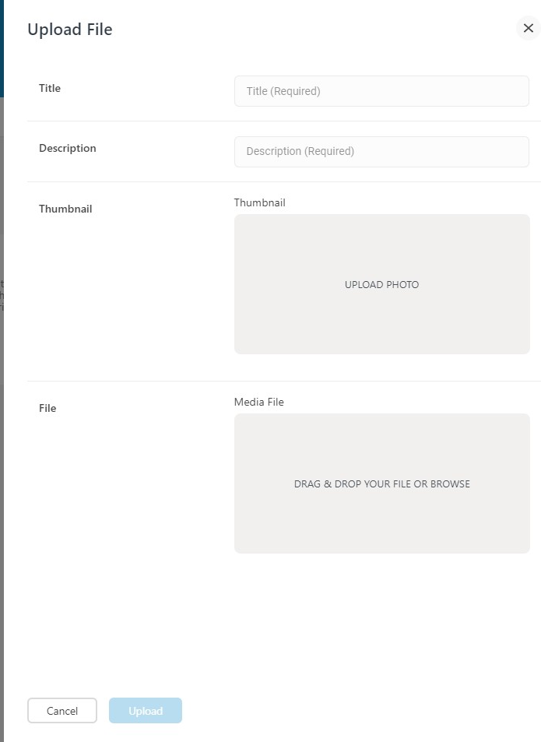
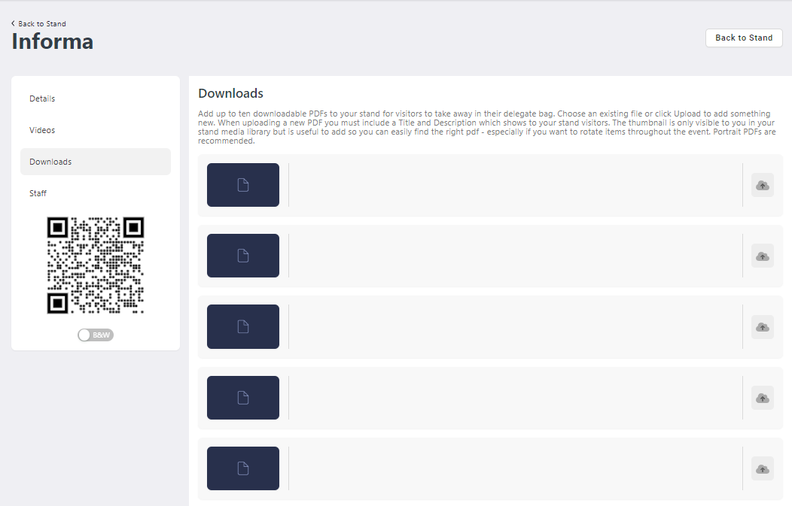
STEP 6 - ADD DOWNLOADABLE DOCUMENTS
Downloads: Add up to 10 downloadable PDFs to your stand.
Choose an existing file or click “the Icon” to add something new. Click the upload button to add.
Add all required information (title, description, thumbnail and file).
Thumbnail:, add a screenshot of the first page. Without a thumbnail, the image will be black on the front end (5MB PNG image).
Portrait downloadable PDFs are recommended.

Slide 17
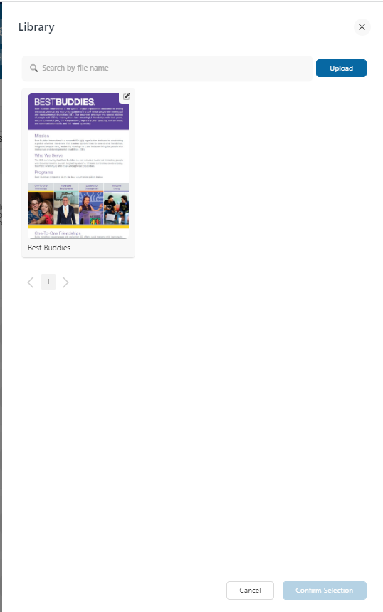
STEP 6 CONT. – ADD DOWNLOADABLE DOCUMENTS
Select the file in the library and press “Confirm Selection”.
Your new document will appear on this page.
You can always come back to this page and edit the title and description if needed.

Slide 18
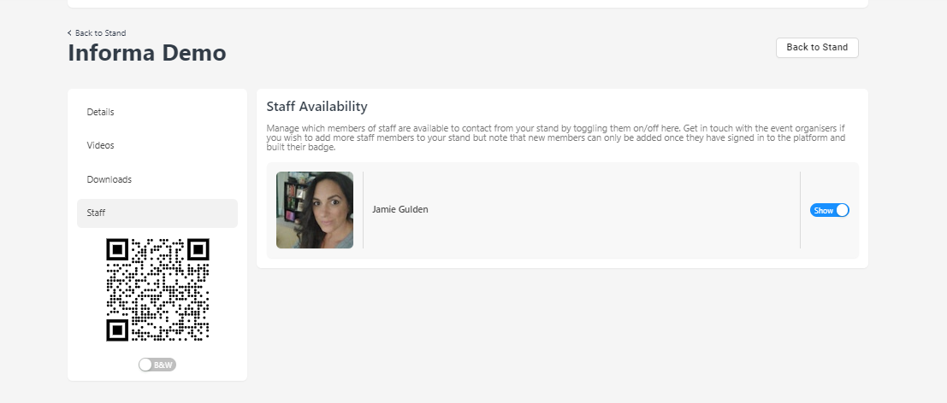
STEP 7 – MANAGE STAFF AVAILABILITY
Staff: Manage staff availability by toggling them on/off.
Get in touch with your operations manager if you team is missing.

Slide 19
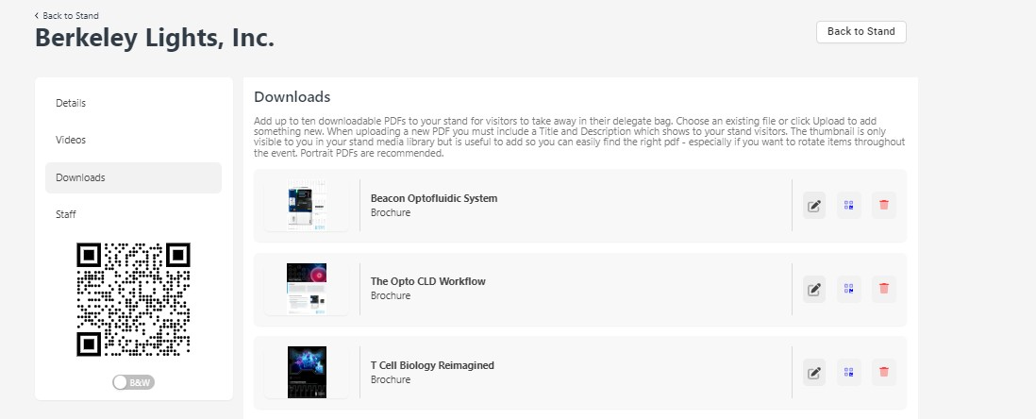
STEP 8 – QR CODES
You can print a QR code which can be scanned by attendees onsite at your booth to download your documents for later viewing. All downloads come in 1 file
Information Classification: General

Slide 20
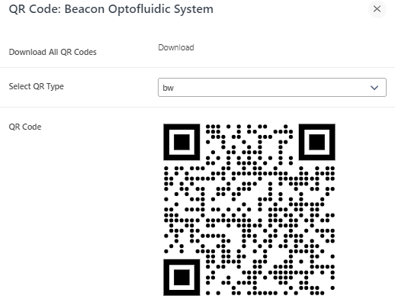
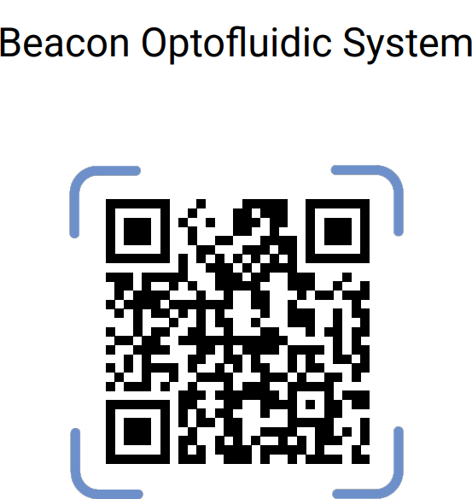
STEP 8 – QR CODES (cont’d)
When you click download, all your uploaded documents will be linked to the respective QR codes for you to print and bring onsite.
Information Classification: General

Slide 21

Lead Retrieval

Slide 22
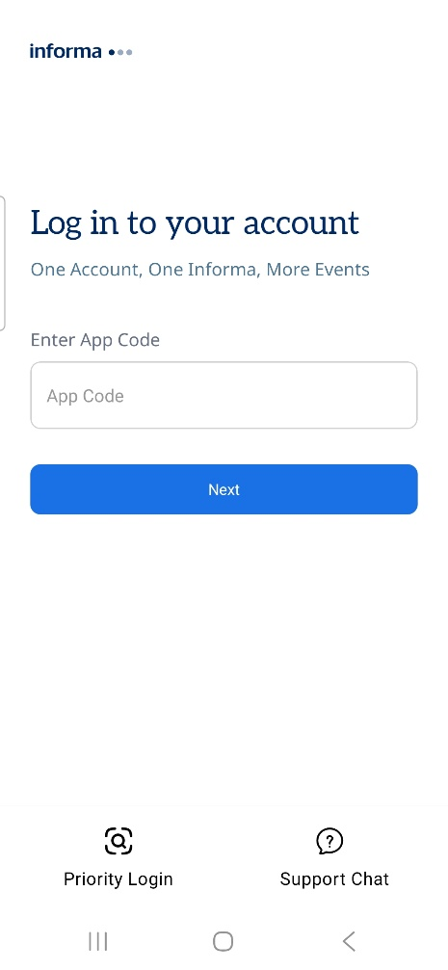
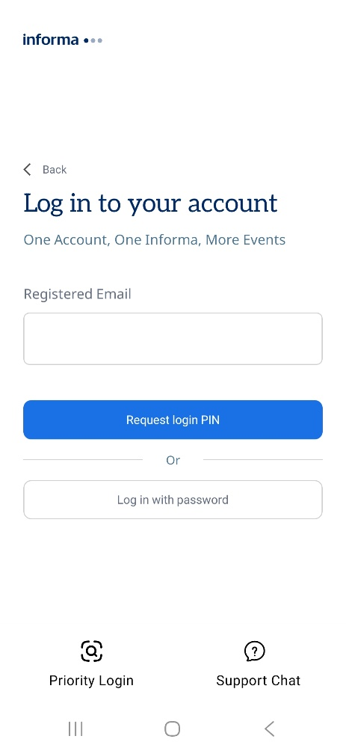
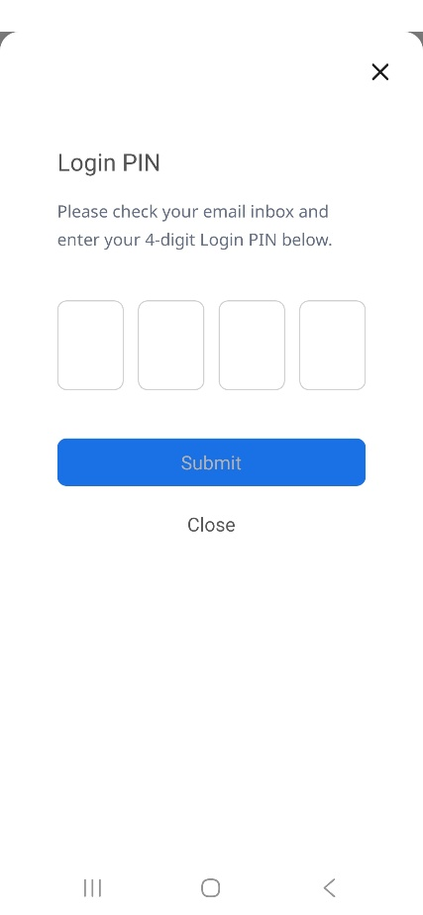
LEAD RETRIEVAL – HOW TO SETUP, SCAN AND COLLECT LEADS ONSITE
On your personal device, please download the ConnectMe app. To find it in the App Store / Google Play, please search ‘ConnectMe by Informa’.
Once downloaded, please enter the event code: GF2026.
Enter your email address used to register for the conference, to which you will receive a 4-digit pin to login
If you do not receive a 4-digit pin, please email

Slide 23
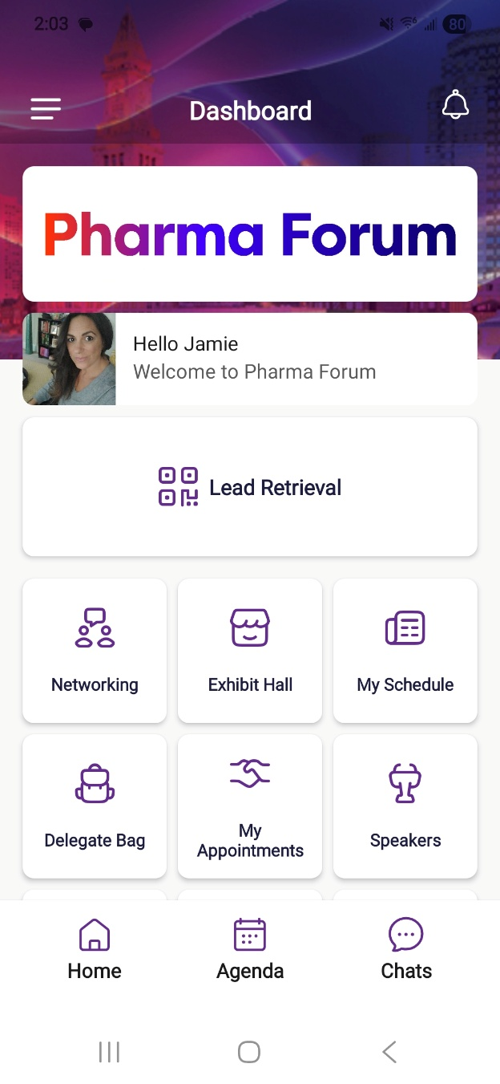
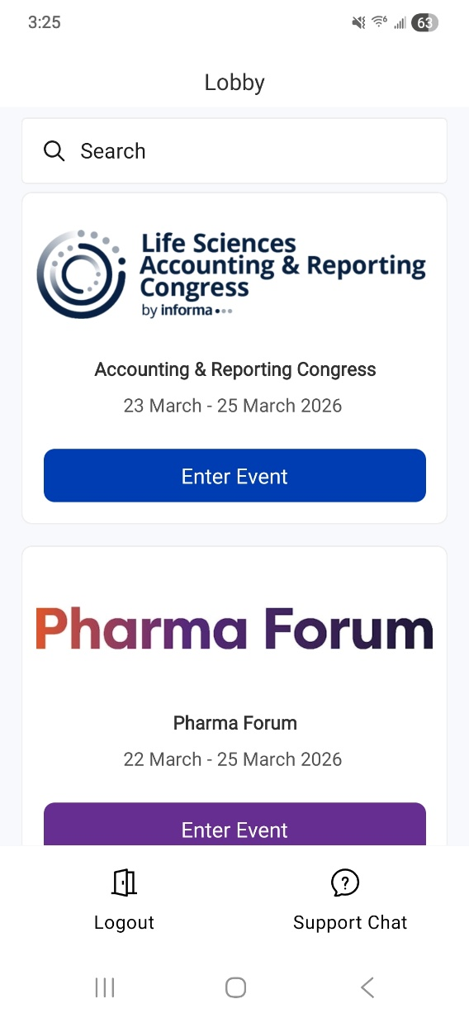

LEAD RETRIEVAL
4. Once entered, please select the SuperReturn International 2026 event to enter. The dashboard on the right should appear and you will have the Lead Retrieval button which will take you to the lead scanning page.
If you do not see this button on your screen, please contact: superreturninternational.ops@informa.com

Slide 24
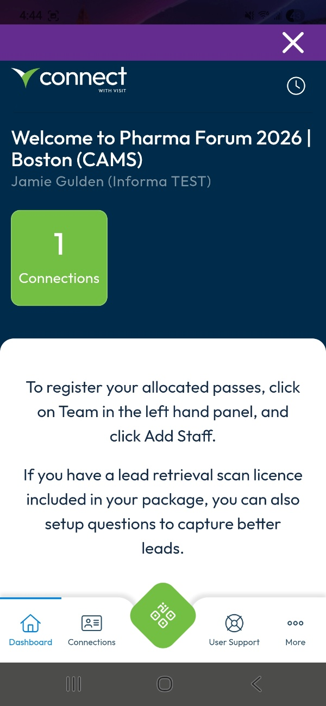
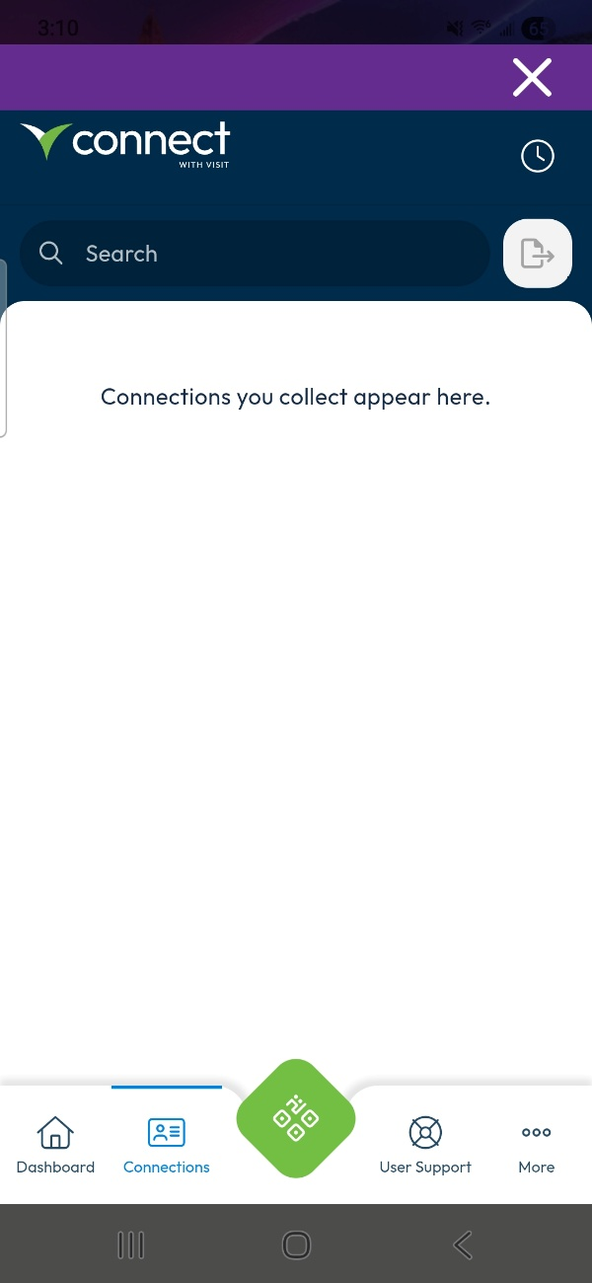
LEAD RETRIEVAL
5. This takes you to the partner portal for capturing leads. To begin scanning click the QR button at the bottom of your screen.
6. Make sure your camera permissions are set to “allowed” in order to scan.
*The specific name of your event will be shown
If you do not see this button on your screen, please contact: superreturninternational.ops@informa.com

Slide 25
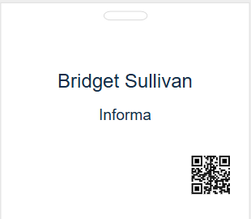
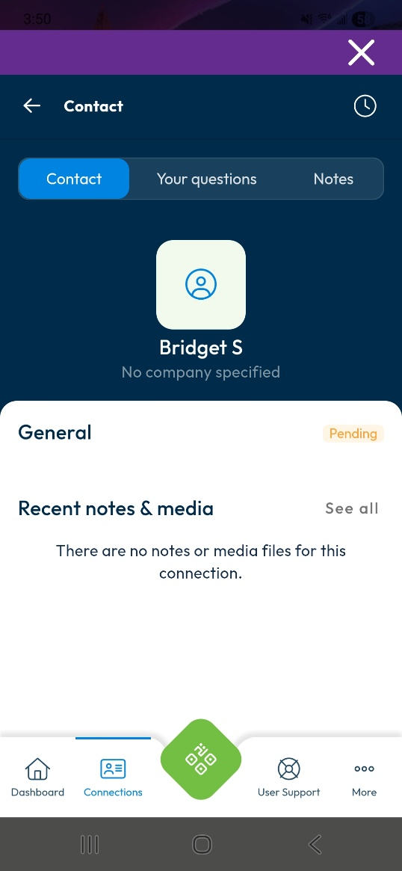
LEAD RETRIEVAL
8. QR codes will be printed on attendee badges onsite which will be easier to scan.
Once scanned, the page will show the attendee details and you are then able to add your own notes/media files and answer any preset questions.
Click the back button at the top left to go back to your main dashboard, which will show all your scanned leads in one place.

Slide 26
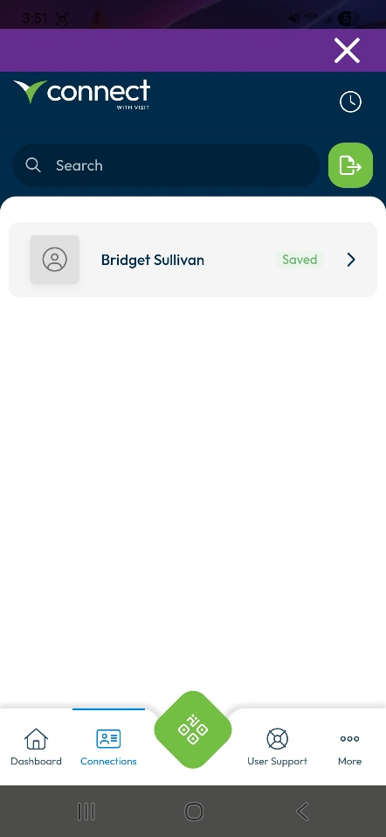
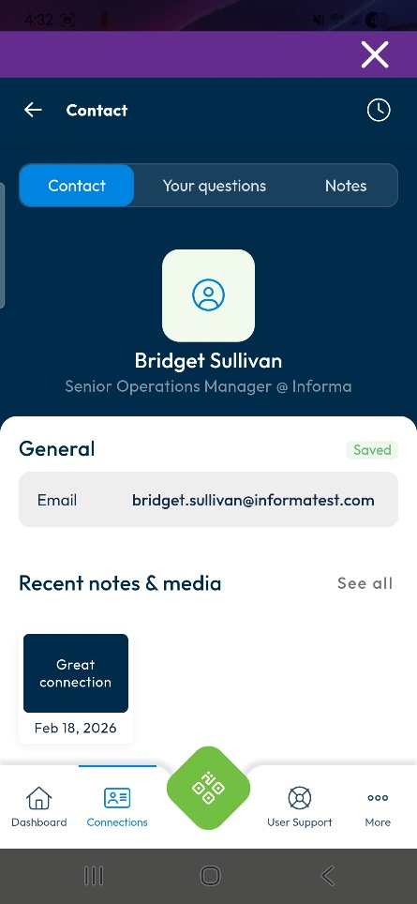
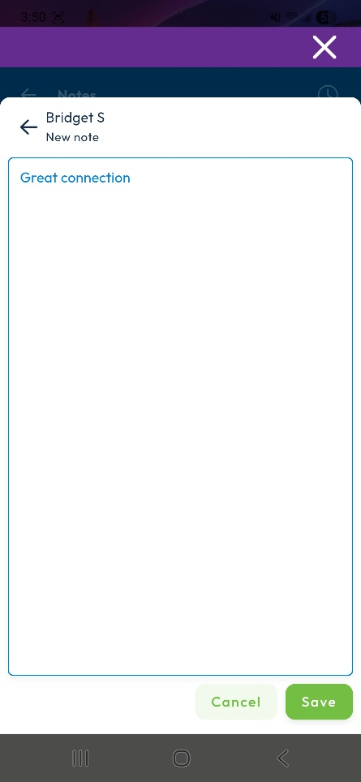

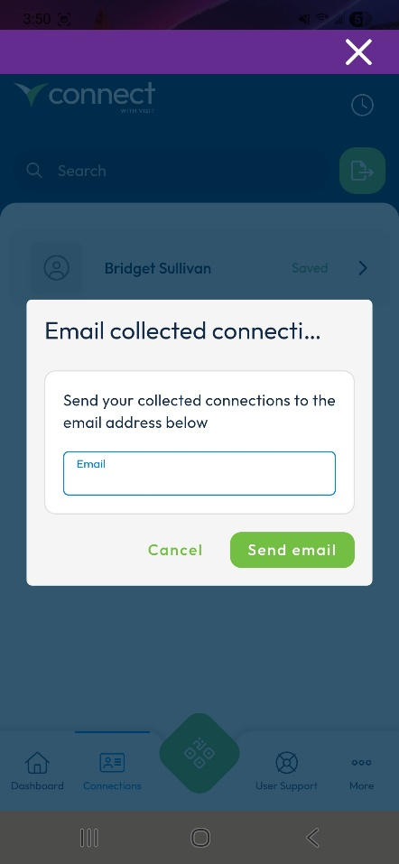
LEAD RETRIEVAL
Scanned badges will be listed
under connections
Preset questions and notes can be added at the time of scanning or later
Scanned leads can be exported to your email in real time, or accessed by your main contact in the Visit Connect Portal

Slide 27
LEAD RETRIEVAL FAQ’s
PRE-EVENT
How do I setup my team so that they have access to capture leads?
As the main contact for your team, login to the Create with Visit portal link sent to you by your operations manager to register your allocated passes for the event. Go to TEAM on the left-hand side navigation bar, and then select Add Staff. Once your team has been entered, they will be automatically setup with access to lead retrieval.
Can I setup custom questions?
Yes – your company’s main contact person can set these for your team via the Create with Visit portal under Questions.
How many custom questions can we have?
You can have an unlimited amount.
Is there a character limit for the questions I set?
There is a 100-character maximum for questions (including spaces).
When is the deadline for customizing questions?
There is no deadline, you can keep updating questions right up until the event.
Is it possible to get a developer’s kit so that we can use our own lead retrieval system?
Unfortunately, it is not possible to use your own lead retrieval system. Lead retrieval for this event can only be used via the system provided through the ConnectMe app. You cannot scan badges with another program.
I want to stop my colleagues attending from downloading leads. Is this possible?
Yes, in your Create with Visit portal, go to TEAM on the left-hand side. Hover your mouse over the attendee whose permission you would like to change and select the Edit icon on the right-hand side. From here, you can change whether that person can: capture leads, export leads, show all leads or have admin permissions.
What does “admin” permission mean?
An Admin user will have access to dashboard, users, profile questions, leads and agenda. This included managing registration and downloading the team’s leads.

Slide 28
LEAD RETRIEVAL FAQ’s
Require help onsite?
Visit the Helpdesk at registration for all Lead Retrieval Support.
DURING THE EVENT
How do I access the lead scanner?
Download ConnectMe by Informa via your smart-device’s app store. Do not let your team of booth scan staff log in directly to the Create with Visit website as it may cause issues with your data.
What is the event code for the ConnectMe App?
GF2026
How do I login to the app?
Enter the email address that was used to register for the event.
How do I scan badges with the ConnectMe App?
Once logged in, on your dashboard you should see a Lead Retrieval button. Click this to begin scanning badges. If you do not see this button, please visit the helpdesk at registration.
Are the leads GDPR compliant?
All attendees are asked an explicit opt-in consent statement as a required stage of the delegate badge process. Please see example here. If your company requires a specific question to be asked, the easiest way of capturing this would be to create a custom question at setup.
Does lead scanning work if there is no internet connection?
Yes, you can still scan badges. The app will synchronise the missing information as soon as you reconnect to the internet. There will be event WiFi available to all attendees.
Can I see the leads I’ve scanned in real-time?
Yes, all the leads you have scanned will show on the lead retrieval dashboard. From there, you can export these leads straight away.
Can I see a consolidated list of leads scanned by my team?
Yes, on the VISIT by GES pass registration portal under Leads, you can view and export your team’s scanned leads. This will show which colleague scanned which delegate line by line.
Can I give permission to my colleagues to view and export all the leads on their devices?
Yes. As an admin user, you can click on the homepage > Team and see all the colleagues who are using Create with Visit. In the Permissions column, there are shown the 4 types of access:
Admin permissions – in this case, the user becomes an admin user
Show all leads – the user will be able to see the leads captured by other team members
Allow capture leads – this option is already enabled when a user is registered
Allow export leads – when enabled, the user can export the leads

Slide 29
LEAD RETRIEVAL FAQ’s
POST EVENT
Where can I find my booth scan leads post-event?
Access Visit Connect from a desktop, you can export a .csv file of your team’s leads including any notes that were made. Your main contact from each company can do this.
In the ConnectMe app- click the Lead Retrieval Button. Choose Connections on the bottom of the screen, and then on the top right is an export option to email your leads to yourself.

Slide 30
Event Contacts

Slide 31




3 Critical Delivery Platforms for Sponsors & Exhibitors
Who has access?
Sponsors, speakers and all attendees
Download the app
Enter App code: GF2026
(Event registration required to use conference app)
*All sponsor team members should see a “Lead Retrieval” button on the home screen of the ConnectMe app.
Access lead retrieval to scan attendee badges*
View attendee directory
Send direct messages and meeting invitations
Set up and view virtual exhibit booths
Access event content agenda
Scan exhibit booth QR codes
CONFERENCE
APP
Key Support Contact
Event Ops
superreturninternational.ops@informa.com
REGISTRATION SYSTEM
Register staff with contracted complimentary event passes
Access all badge scan data captured by your team
View badge scan notes
Set up custom badge scan questions
Who has access?
Sponsor’s main contact only
Your main contact will receive pre-event access via email to set up your team registration and lead retrieval
Key Support Contact
Exhibitor Ops gfsupport@informa.com
Access all your event leads, including session attendance, booth/badge scans, virtual booth visits, and more
View individuals/companies that are most engaged with your company
Export your full event lead data
Lead data is updated throughout event
Who has access?
Contract signer and main contact
You’ll receive an email pre-event with access to your account, and you can extend access to colleagues. If you have questions about your lead data or access, please contact us.
LEAD REPORTING & ANALYTICS
Key Support Contact
Lead Data Delivery
leadinsights@informa.com

