Slide 1
Sponsor Guide
Global Finance
RiskMinds 2026

Slide 2
Table Of Contents
Please click on a link below to go to directly to that section of the guide.
Lead Retrieval |(Slides 3-7)
Your Lead Insights |(Slides 8-11)

Slide 3

Lead Retrieval

Slide 4
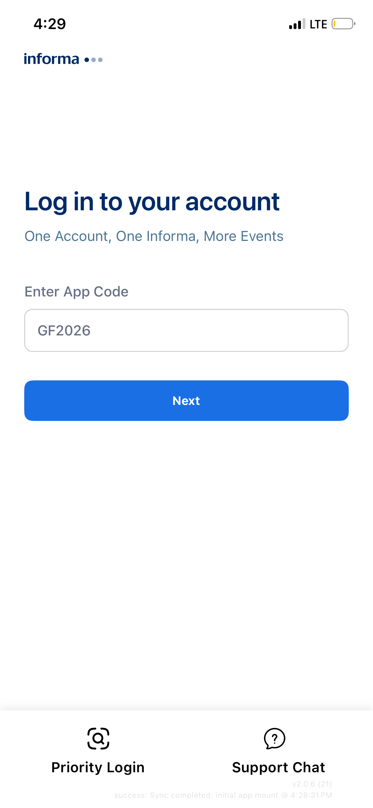
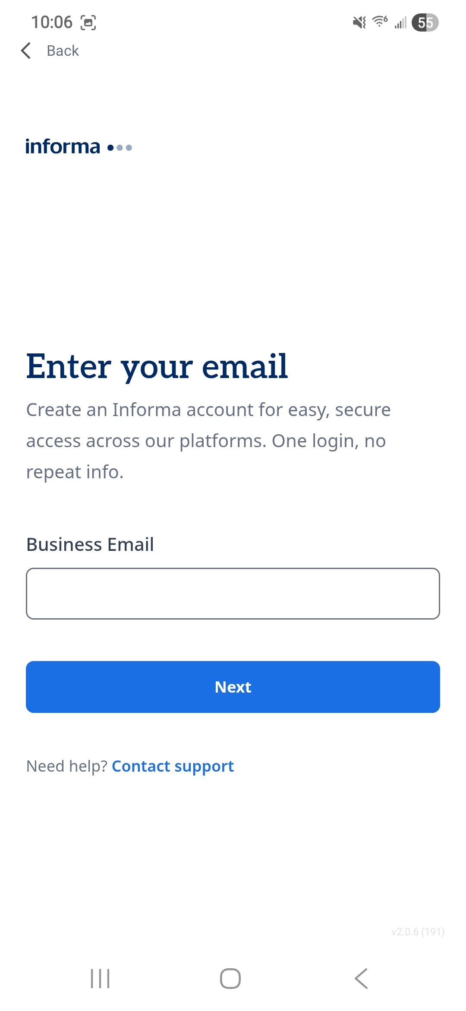
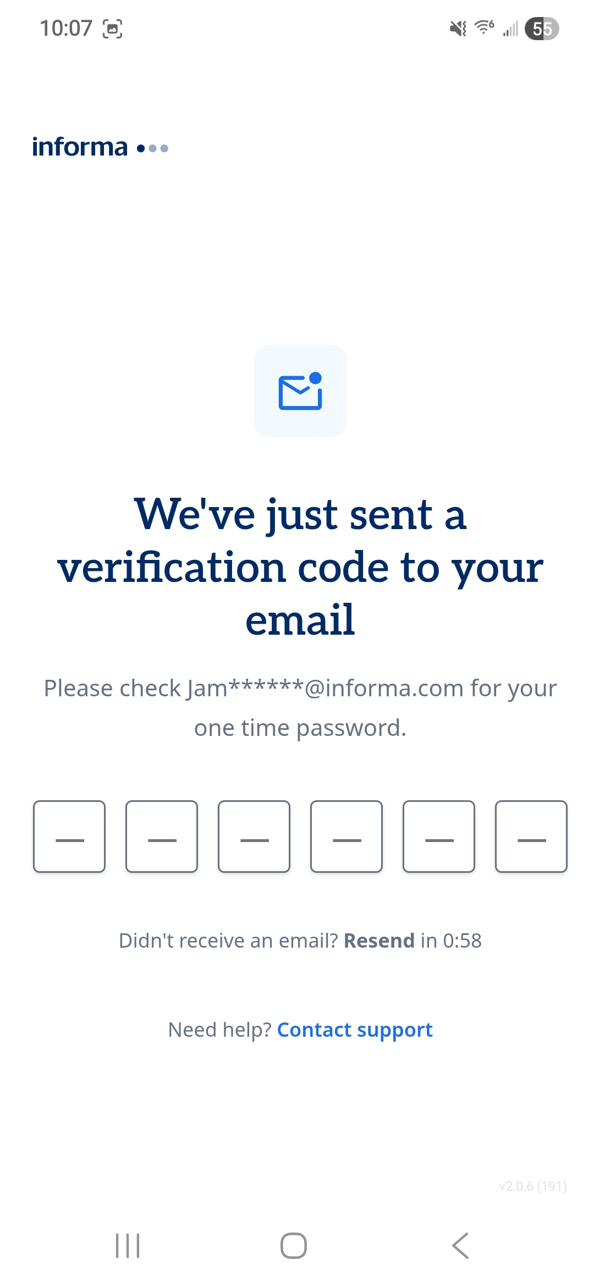
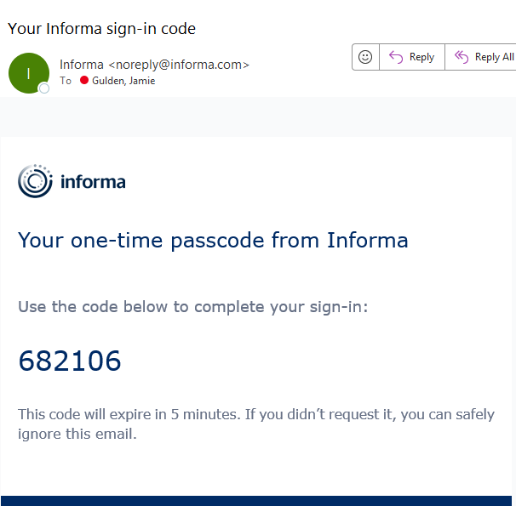
LEAD RETRIEVAL – HOW TO SETUP, SCAN & COLLECT LEADS ONSITE
On your phone or tablet, please download the ConnectMe app. To find it in the App Store / Google Play, please search ‘ConnectMe by Informa’.
Once downloaded, please enter the App code: GF2026
Enter your email address used to register for the conference, to which you will receive a 6-digit pin to login
If you do not receive a 6-digit pin, please use ‘Contact Support’.
If you do not receive a 4-digit pin, please email

Slide 5
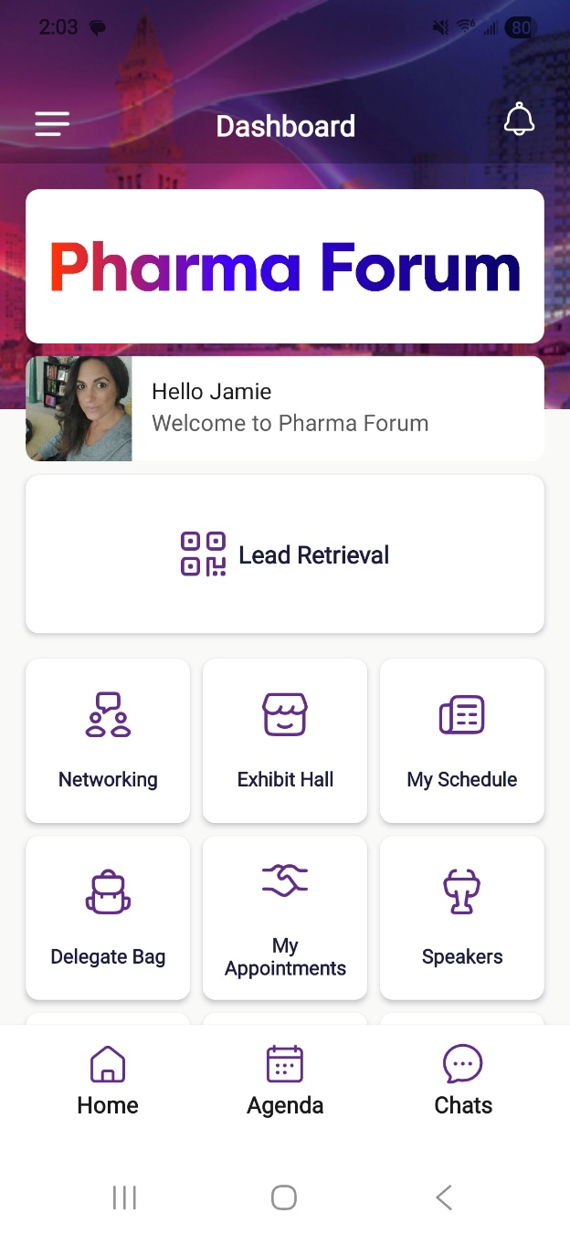
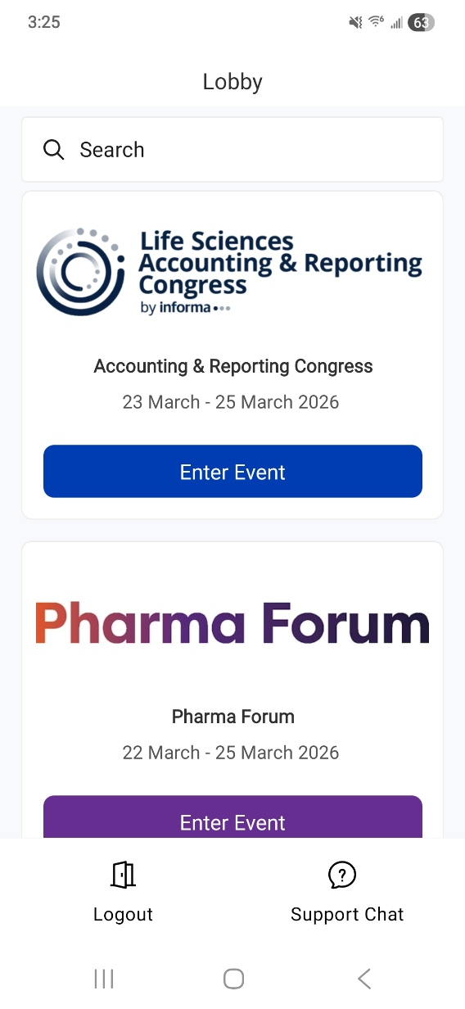

LEAD RETRIEVAL
4. Once entered, please select the event to enter. The dashboard on the right will appear and you will have the Lead Retrieval button which will take you to the lead scanning page.
If you do not see this button on your screen, please contact your Digital Event Ops Contact which can be found at the end of this document.

Slide 6
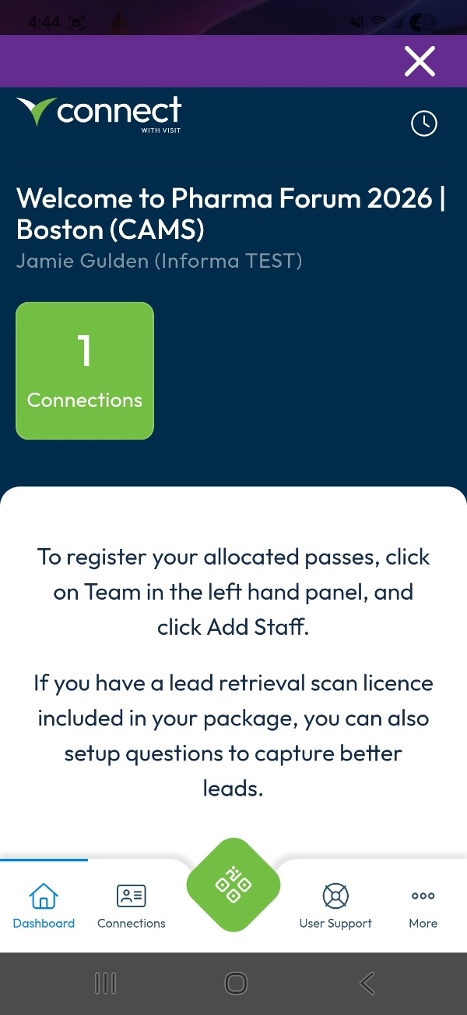
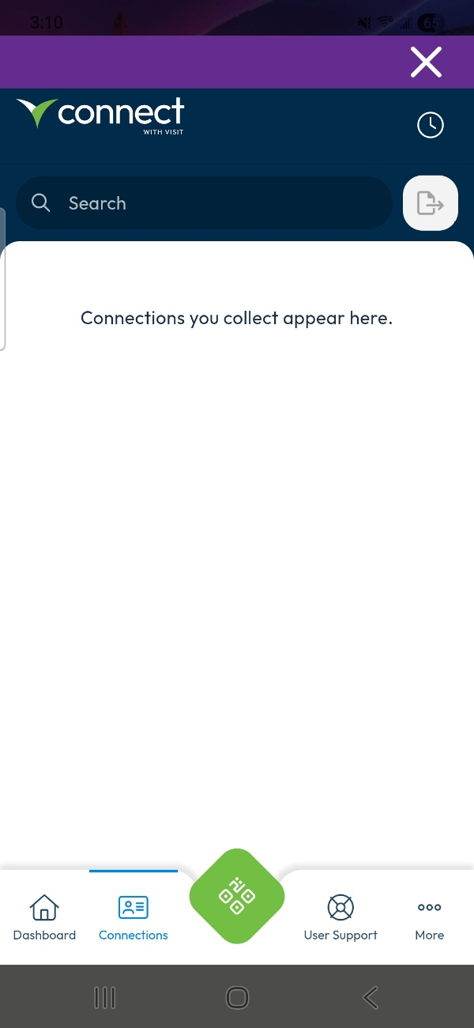
LEAD RETRIEVAL cont…
5. This takes you to the partner portal for
capturing leads. To begin scanning click the
QR button at the bottom of your screen. ​
​
​
6. Make sure your camera permissions are set to
“allowed” in order to scan.
*The specific name of your event will be shown

Slide 7
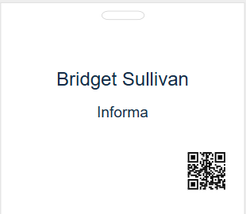
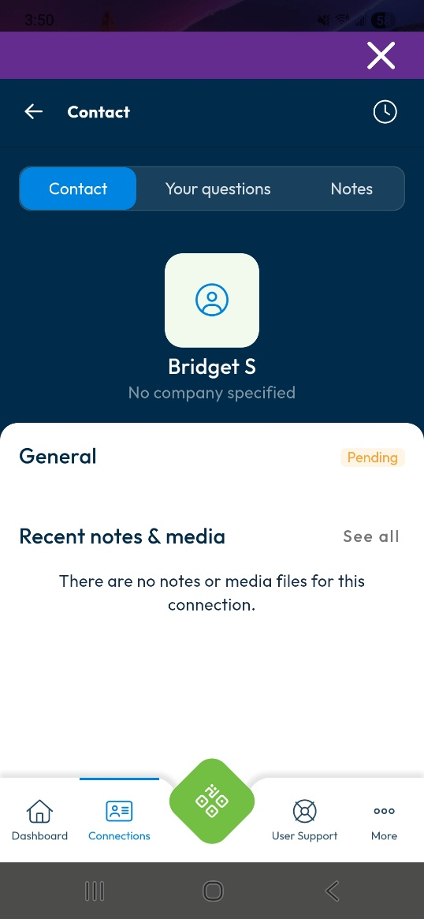
LEAD RETRIEVAL cont…
7. QR codes will be printed on attendee badges as seen in this example.
When scanning, please ensure you are scanning the QR code on the attendee badge, and not the QR code attached to their lanyard.
Once scanned, the page will show the attendee details and you are then able to add your own notes/media files and answer any preset questions that your company has added.
8. Click the back button at the top left to go back to your main dashboard. This will show all the leads you’ve personally scanned.
*The specific name of your event will be shown
This badge is an example and can not be scanned

Slide 8
Your Lead Insights Dashboard

Slide 9
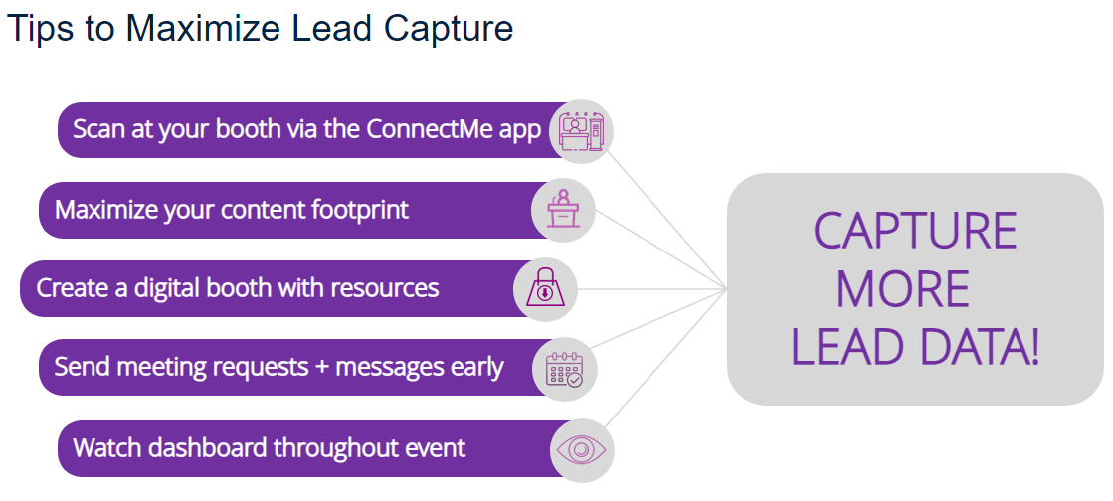
ACCESS YOUR LEAD DATA
Your dashboard contains all event lead data in a single view. Pre-event, you will receive an automated email from "Lead Insights" with instructions for setting up your account. The timing for data to populate your report will vary by event so contact leadinsights@informa.com or your account manager for more details.
Keep in mind that your company’s primary contact also has real-time access to your raw scan data if exported directly from the "Lead Retrieval" section in ConnectMe. For questions contact us.

Slide 10
Engagement Types found on your Lead Insights report
Activity Type​​​ | Description​​​
Ad Click​​​ | Delegate clicked an in-platform banner ad from your company (not applicable to most sponsors)​​​
Booth Visit - Digital​​​ | Attendee visited your company’s showcase page​​​
Booth Visit - Onsite​​​ | Delegate scanned by your staff at the onsite exhibition​​​
Content View – Digital Showcase/Exhibit​​​ | Delegate scanned a QR code at your onsite booth to add your collateral or booth listing to their delegate bag (not applicable to some events)​​​
Meeting Schedule​​​d | Pre-arranged meeting with a specific time accepted between your staff and a delegate​​​
Meeting Unconfirmed​​​ | Delegate requested a meeting with your staff with no response from your staff​​​
Poll Respondent​​​ | Delegated answered your sponsored poll question​​​
Poster View​​​ | Delegate viewed and/or downloaded your sponsored poster presentation​​​
QR Code Scan - Onsite​​​ | Delegate scanned a QR code at your onsite booth to add your collateral or booth listing to their delegate bag​​​
Scheduled Session​​​ | Delegate added your sponsored session to their custom agenda​​​
Session Attend – Live Digital​​​ | Attended a live session sponsored by or presented by your staff on the digital platform​​​
Session Attend - OD​​​ | Delegate viewed an on-demand session sponsored by your company​​​
Session Attend - Onsite​​​ | Attended a live face-to-face session sponsored by or presented by your staff​​​
Session Question​​​ | Question submitted in association with your session (live or on-demand) ​​​

Slide 11



3 Critical Delivery Platforms for Sponsors & Exhibitors
Access lead retrieval to scan attendee badges*
View attendee directory
Send direct messages and meeting invitations
Set up and view virtual exhibit booths
Access event content agenda
Stream live (hybrid events) and on-demand sessions
Scan exhibit booth QR codes
Who has access?
Sponsors, speakers and all attendees
  Download the app
  Enter App code: GF2026
  (Event registration required to use conference app)
*All sponsor team members should see a “Lead Retrieval” button on the home screen of the ConnectMe app.
CONFERENCE
APP
Key Support Contact
Event Ops
[email@informa.com]
REGISTRATION SYSTEM
Register staff with contracted complimentary event passes
Access all badge scan data captured by your team
View badge scan notes
Set up custom badge scan questions
Who has access?
Sponsor’s main contact only
Your main contact will receive pre-event access via email to set up your team registration and lead retrieval
Key Support Contact
Exhibitor Ops
[email@informa.com]
Access all your event leads, including session attendance, booth/badge scans, scan notes, virtual booth visits, and more
View individuals/companies that are most engaged with your company
Export your full event lead data
Lead data is updated throughout event
Who has access?
Contract signer and main contact
You’ll receive an email pre-event with access to your account, and you can extend access to colleagues. If you have questions about your lead data or access, please contact us.
LEAD REPORTING & ANALYTICS
Key Support Contact
Lead Data Delivery
leadinsights@informa.com
Sponsor Guide

