Slide 1
Exhibitor Sustainability Checklist
We aim for all of our events to be run in an environmentally and socially responsible way whilst seeking to inspire sustainable development in our markets.
We do this not only because more than 80% of our attendees tell us that they care that our events are run in a responsible manner, but because it is the right thing to do for our customers, colleagues, and the communities we serve.
We would like to encourage you to join our sustainability efforts by completing the 10 point checklist enclosed in this document.
By working together, we can make the event more memorable, meet our audience’s expectations and reduce wasted time, resources, and costs.
v1.0

Slide 2
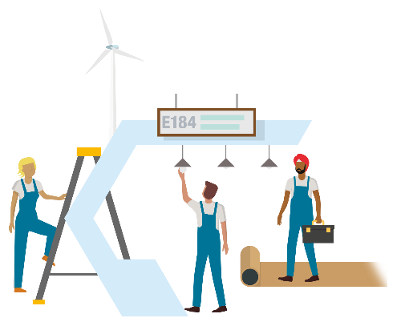
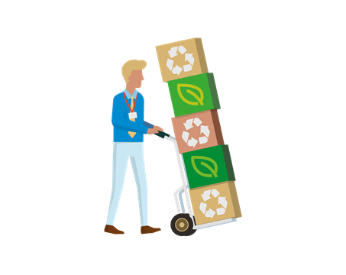
Exhibitor Sustainability Checklist
10 things to remember
Ensure your stand is designed so that its structure will be used again by either
yourself or by your contractors.
1
Select energy efficient, LED lighting and other equipment for your stand and be sure to
power down your equipment at the end of the day.
2
Think about what waste your stand will create and try to minimize it as much as possible. For the unavoidable waste items,
try to ensure it will be recycled. Key items to consider include signage, carpeting and packaging waste.
3
Ensure you and your contractor are aware of and compliant with all health,
safety and security requirements.
4
For your travel and transport choose the most sustainable option possible for your journey to and from the event. Consolidate your shipments and use logistic companies that have sustainability credentials.
5
Continued overleaf.

Slide 3
Want a supplier you can trust? We have developed long-term relationships with the most quality focused, reliable and responsive vendors in the industry. Our preferred partners can help you to exhibit sustainably and we encourage you to engage with them for any logistic, stand build, signage, lightning or accommodation needs you may have.
Reduce paper handouts by going digital and source recycled, sustainably certified paper
options where printing is needed.
6
When purchasing promotional items, consider the amount you order, the environmental credentials of the materials
they are made from, as well as whether they are useful giveaways that will be used long after the event is over.
7
Help to support the sustainability of the local area by using local suppliers and
considering the sustainability credentials of the hotels you book.
8
Get involved with the numerous initiatives and conversations throughout the event
which aim to help facilitate and inspire the sustainable development of your industry.
9
Inspire the sustainable development of your industry by promoting your company’s and your
products’ sustainability credentials.
10
Would you like to work with us on the sustainability of the event? Contact the event team or reach out to Informa’s sustainability team for more information at sustainability@informa.com

Slide 4
What is Better Stands?
Have you ever considered what happens to your stand after an event?
The Better Stands programme is aimed to unite and encourage exhibitors, along with their appointed contractors to move away from disposable, single use stands at events.
A disposable stand/booth is a space only/raw space build that is used only once. They are typically constructed from poor quality raw materials onsite which are then demolished post show - sent to either landfill or burnt for energy.
The Better Stands programme has been divided into three key stages - Bronze, Silver, and Gold. This helps facilitate a gradual transition from disposable to reusable stands for all exhibitors.
There are many benefits of the Better Stands programme to exhibitors, some of which include:
It creates a better working environment onsite, as reusable stands are safer to build
Reduces waste and carbon emissions
Reduces exhibitor waste bill, as well as hours onsite so reduced contractor costs
Disposable
Reusable
Notes:
The Better Stands programme is aimed to unite and encourage exhibitors, along with their appointed contractors to move away from disposable, single use stands at events, in favour of re-usable & then ultimately recyclable structures.
A disposable stand is a space only stand that is used only once. They are typically constructed from poor quality raw materials onsite which are then demolished post show - sent to either landfill or burnt for energy.
The Better Stands programme has been divided into three key stages - Bronze, Silver, and Gold. This helps facilitate a gradual transition from disposable to reusable stands for all exhibitors.

Slide 5
Key Stages of Better Stands
To make your commitment to Better Stands and contribute to a more sustainable event:
Read the Better Stands framework below
Ensure your stand reaches at least a bronze level, meaning the stand structure and walls, platform, furniture, equipment and lighting are all reused
Share these guidelines with your contractor before they begin designing your stand
Ensure that the submitted stand design clearly communicates how you will meet the Better Stands guidelines

